Slide 1
Cryptography and Network Security
UNIT 2

Slide 2
UNIT 1

Slide 3
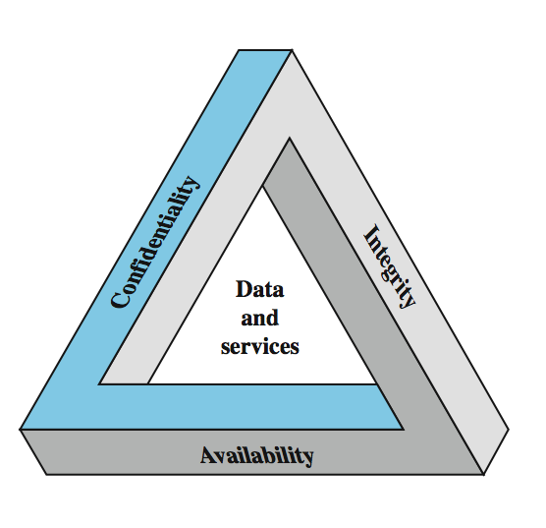
Key Security Concepts
Notes:
These three concepts form what is often referred to as the CIA triad (Figure 1.1). The three concepts embody the fundamental security objectives for both data and for information and computing services. FIPS PUB 199 provides a useful characterization of these three objectives in terms of requirements and the definition of a loss of security in each category:
• Confidentiality (covers both data confidentiality and privacy): preserving authorized restrictions on information access and disclosure, including means for protecting personal privacy and proprietary information. A loss of confidentiality is the unauthorized disclosure of information.
• Integrity (covers both data and system integrity): Guarding against improper information modification or destruction, and includes ensuring information non-repudiation and authenticity. A loss of integrity is the unauthorized modification or destruction of information.
• Availability: Ensuring timely and reliable access to and use of information. A loss of availability is the disruption of access to or use of information or an information system.
Although the use of the CIA triad to define security objectives is well established, some in the security field feel that additional concepts are needed to present a complete picture. Two of the most commonly mentioned are:
• Authenticity: The property of being genuine and being able to be verified and trusted; confidence in the validity of a transmission, a message, or message originator.
• Accountability: The security goal that generates the requirement for actions of an entity to be traced uniquely to that entity.
3

Slide 4
Aspects of Security
consider 3 aspects of information security:
  security attack
  security mechanism (control)
  security service
note terms
  threat – a potential for violation of security
  vulnerability – a way by which loss can happen
  attack – an assault on system security, a deliberate attempt to evade security services
Notes:
4
The OSI security architecture focuses on security attacks, mechanisms, and services. These can be defined briefly as follows:
• Security attack: Any action that compromises the security of information owned by an organization.
• Security mechanism: A process (or a device incorporating such a process) that is designed to detect, prevent, or recover from a security attack.
• Security service: A processing or communication service that enhances the security of the data processing systems and the information transfers of an organization. The services are intended to counter security attacks, and they make use of one or more security mechanisms to provide the service.
In the literature, the terms threat and attack are commonly used to mean more or less the same thing. Table 1.1 provides definitions taken from RFC 2828, Internet Security Glossary.
Threat - A potential for violation of security, which exists when there is a circumstance, capability, action, or event that could breach security and cause harm. That is, a threat is a possible danger that might exploit a vulnerability.
Attack - An assault on system security that derives from an intelligent threat; that is, an intelligent act that is a deliberate attempt (especially in the sense of a method or technique) to evade security services and violate the security policy of a system.

Slide 5
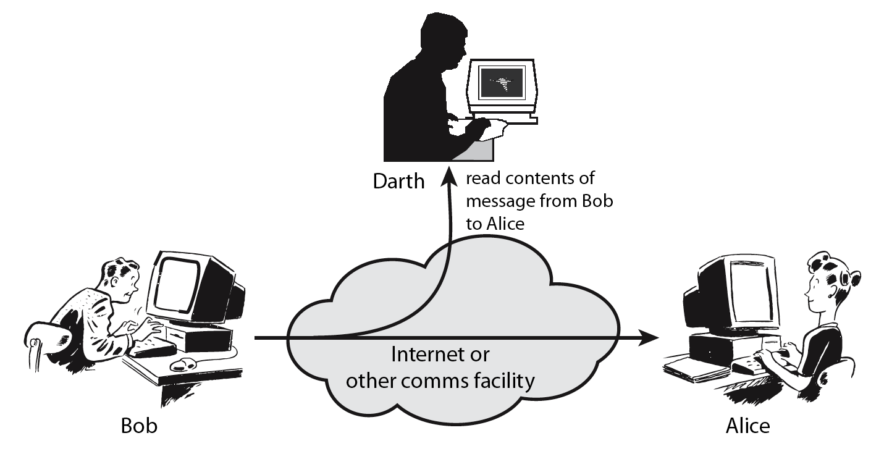
Passive Attack - Interception
Notes:
5
A useful means of classifying security attacks, used both in X.800 and RFC 2828, is in terms of passive attacks and active attacks. A passive attack attempts to learn or make use of information from the system but does not affect system resources.
Passive attacks are in the nature of eavesdropping on, or monitoring of, transmissions. The goal of the opponent is to obtain information that is being transmitted. Two types of passive attacks are:
+ release of message contents - as shown above in Stallings Figure 1.2a here
+ traffic analysis - monitor traffic flow to determine location and identity of communicating hosts and could observe the frequency and length of messages being exchanged
These attacks are difficult to detect because they do not involve any alteration of the data.

Slide 6
Passive Attack: Traffic Analysis
Observe traffic pattern
Notes:
6
A useful means of classifying security attacks, used both in X.800 and RFC 2828, is in terms of passive attacks and active attacks. A passive attack attempts to learn or make use of information from the system but does not affect system resources.
Passive attacks are in the nature of eavesdropping on, or monitoring of, transmissions. The goal of the opponent is to obtain information that is being transmitted. Two types of passive attacks are:
+ release of message contents - as shown above in Stallings Figure 1.2a here
+ traffic analysis - monitor traffic flow to determine location and identity of communicating hosts and could observe the frequency and length of messages being exchanged
These attacks are difficult to detect because they do not involve any alteration of the data.

Slide 7
Active Attack: Interruption
Block delivery of message
Notes:
7
A useful means of classifying security attacks, used both in X.800 and RFC 2828, is in terms of passive attacks and active attacks. A passive attack attempts to learn or make use of information from the system but does not affect system resources.
Passive attacks are in the nature of eavesdropping on, or monitoring of, transmissions. The goal of the opponent is to obtain information that is being transmitted. Two types of passive attacks are:
+ release of message contents - as shown above in Stallings Figure 1.2a here
+ traffic analysis - monitor traffic flow to determine location and identity of communicating hosts and could observe the frequency and length of messages being exchanged
These attacks are difficult to detect because they do not involve any alteration of the data.

Slide 8
Active Attack: Fabrication
Fabricate message
Notes:
8
A useful means of classifying security attacks, used both in X.800 and RFC 2828, is in terms of passive attacks and active attacks. A passive attack attempts to learn or make use of information from the system but does not affect system resources.
Passive attacks are in the nature of eavesdropping on, or monitoring of, transmissions. The goal of the opponent is to obtain information that is being transmitted. Two types of passive attacks are:
+ release of message contents - as shown above in Stallings Figure 1.2a here
+ traffic analysis - monitor traffic flow to determine location and identity of communicating hosts and could observe the frequency and length of messages being exchanged
These attacks are difficult to detect because they do not involve any alteration of the data.

Slide 9
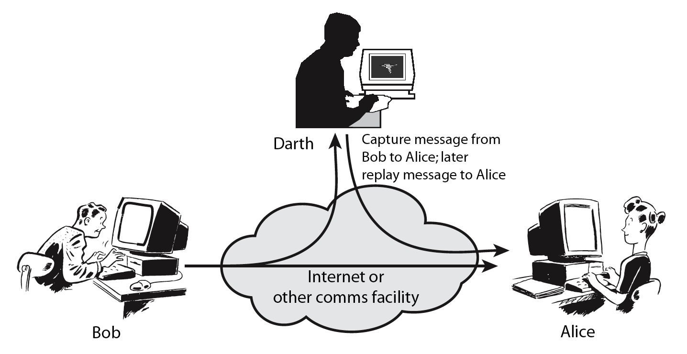
Active Attack: Replay
Notes:
9
Active attacks involve some modification of the data stream or the creation of a false stream and can be subdivided into four categories: masquerade, replay, modification of messages, and denial of service:
masquerade of one entity as some other
replay previous messages (as shown above in Stallings Figure 1.3b)
modify/alter (part of) messages in transit to produce an unauthorized effect
denial of service - prevents or inhibits the normal use or management of communications facilities
Active attacks present the opposite characteristics of passive attacks. Whereas passive attacks are difficult to detect, measures are available to prevent their success. On the other hand, it is quite difficult to prevent active attacks absolutely, because of the wide variety of potential physical, software, and network vulnerabilities. Instead, the goal is to detect active attacks and to recover from any disruption or delays caused by them.

Slide 10
Active Attack: Modification
Modify message
Notes:
10
Active attacks involve some modification of the data stream or the creation of a false stream and can be subdivided into four categories: masquerade, replay, modification of messages, and denial of service:
masquerade of one entity as some other
replay previous messages (as shown above in Stallings Figure 1.3b)
modify/alter (part of) messages in transit to produce an unauthorized effect
denial of service - prevents or inhibits the normal use or management of communications facilities
Active attacks present the opposite characteristics of passive attacks. Whereas passive attacks are difficult to detect, measures are available to prevent their success. On the other hand, it is quite difficult to prevent active attacks absolutely, because of the wide variety of potential physical, software, and network vulnerabilities. Instead, the goal is to detect active attacks and to recover from any disruption or delays caused by them.

Slide 11
Handling Attacks
  Passive attacks – focus on Prevention
    Easy to stop
    Hard to detect
  Active attacks – focus on Detection and Recovery
    Hard to stop
    Easy to detect
Notes:
11
Consider the role of a security service, and what may be required.
Note both similarities and differences with traditional paper documents, which for example:
have signatures & dates;
need protection from disclosure, tampering, or destruction;
may be notarized or witnessed;
may be recorded or licensed

Slide 12
Security Service
  enhance security of data processing systems and information transfers of an organization
  intended to counter security attacks
  using one or more security mechanisms
  often replicates functions normally associated with physical documents
    which, for example, have signatures, dates; need protection from disclosure, tampering, or destruction; be notarized or witnessed; be recorded or licensed
Notes:
12
Consider the role of a security service, and what may be required.
Note both similarities and differences with traditional paper documents, which for example:
have signatures & dates;
need protection from disclosure, tampering, or destruction;
may be notarized or witnessed;
may be recorded or licensed

Slide 13
Security Services (X.800)
Authentication - assurance that communicating entity is the one claimed
  have both peer-entity & data origin authentication
Access Control - prevention of the unauthorized use of a resource
Data Confidentiality –protection of data from unauthorized disclosure
Data Integrity - assurance that data received is as sent by an authorized entity
Non-Repudiation - protection against denial by one of the parties in a communication
Availability – resource accessible/usable
Notes:
13
This list is taken from Stallings Table 1.2 which provides details of the 5 Security Service categories and the 14 specific services given in X.800.
This list includes the various "classic" security services which are traditionally discussed. Note there is a degree of ambiguity as to the meaning of these terms, and overlap in their use. The broad service categories are:
authentication is concerned with assuring that a communication is authentic. Two specific authentication services are defined in X.800: Peer entity authentication: provides corroboration of the identity of a peer entity in an association; and Data origin authentication: provides corroboration of the source of a data unit.
access control is the ability to limit and control the access to host systems and applications via communications links.
confidentiality is the protection of transmitted data from passive attacks, and the protection of traffic flow from analysis.
integrity assures that messages are received as sent, with no duplication, insertion, modification, reordering, replay, or loss.
availability is the property of a system / resource being accessible and usable upon demand by an authorized system entity, according to performance specifications for the system.

Slide 14
Security Mechanisms (X.800)
specific security mechanisms:
  encipherment, digital signatures, access controls, data integrity, authentication exchange, traffic padding, routing control, notarization
pervasive security mechanisms:
  trusted functionality, security labels, event detection, security audit trails, security recovery
Notes:
14
Some examples of mechanisms from X.800. Note that the “specific security mechanisms” are protocol layer specific, whilst the “pervasive security mechanisms” are not. We will meet some of these mechanisms in much greater detail later.
See Stallings Table 1.3 for details of these mechanisms in X.800, and Table 1.4 for the relationship between services and mechanisms.

Slide 15
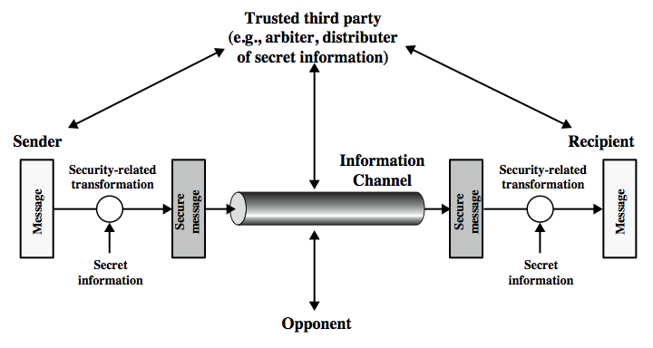
Model for Network Security
Notes:
15
In considering the place of encryption, its useful to use the following two models from Stallings section 1.6.
The first, illustrated in Figure 1.4, models information being transferred from one party to another over an insecure communications channel, in the presence of possible opponents. The two parties, who are the principals in this transaction, must cooperate for the exchange to take place. They can use an appropriate security transform (encryption algorithm), with suitable keys, possibly negotiated using the presence of a trusted third party. Parts One through Four of this book concentrates on the types of security mechanisms and services that fit into the model shown here.

Slide 16
Symmetric Encryption
or conventional / private-key / single-key
sender and recipient share a common key
all classical encryption algorithms are private-key
was only type prior to invention of public-key in 1970’s
and by far most widely used
Notes:
Symmetric encryption, also referred to as conventional encryption or single-key encryption, was the only type of encryption in use prior to the development of public-key encryption in the 1970s. It remains by far the most widely used of the two types of encryption. All traditional schemes are symmetric / single key / private-key encryption algorithms, with a single key, used for both encryption and decryption. Since both sender and receiver are equivalent, either can encrypt or decrypt messages using that common key.

Slide 17
Some Basic Terminology
plaintext - original message
ciphertext - coded message
cipher - algorithm for transforming plaintext to ciphertext
key - info used in cipher known only to sender/receiver
encipher (encrypt) - converting plaintext to ciphertext
decipher (decrypt) - recovering ciphertext from plaintext
cryptography - study of encryption principles/methods
cryptanalysis (codebreaking) - study of principles/ methods of deciphering ciphertext without knowing key
cryptology - field of both cryptography and cryptanalysis
Notes:
Briefly review some terminology used throughout the course.

Slide 18
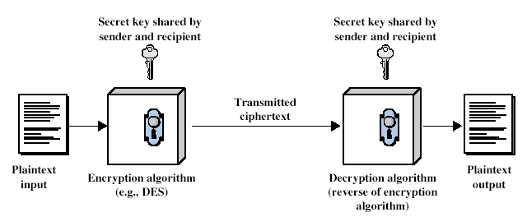
Symmetric Cipher Model
Notes:
Detail the five ingredients of the symmetric cipher model, shown in Stallings Figure 2.1:
plaintext - original message
encryption algorithm – performs substitutions/transformations on plaintext
secret key – control exact substitutions/transformations used in encryption algorithm
ciphertext - scrambled message
decryption algorithm – inverse of encryption algorithm

Slide 19
Requirements
two requirements for secure use of symmetric encryption:
  a strong encryption algorithm
  a secret key known only to sender / receiver
mathematically have:
  Y = E_{K}(X)
  X = D_{K}(Y)
assume encryption algorithm is known
implies a secure channel to distribute key
Notes:
We assume that it is impractical to decrypt a message on the basis of the cipher- text plus knowledge of the encryption/decryption algorithm, and do not need to keep the algorithm secret; rather we only need to keep the key secret. This feature of symmetric encryption is what makes it feasible for widespread use. It allows easy distribution of s/w and h/w implementations.
Can take a closer look at the essential elements of a symmetric encryption scheme: mathematically it can be considered a pair of functions with: plaintext X, ciphertext Y, key K, encryption algorithm E_{K}, decryption algorithm D_{K}.

Slide 20
Cryptography
characterize cryptographic system by:
  type of encryption operations used
    substitution / transposition / product
  number of keys used
    single-key or private / two-key or public
  way in which plaintext is processed
    block / stream
Notes:
Cryptographic systems can be characterized along these three independent dimensions.

Slide 21
Cryptanalysis
objective to recover key not just message
general approaches:
  cryptanalytic attack
  brute-force attack
Notes:
Typically objective is to recover the key in use rather then simply to recover the plaintext of a single ciphertext.
There are two general approaches:
Cryptanalytic attacks rely on the nature of the algorithm plus perhaps some knowledge of the general characteristics of the plaintext or even some sample plaintext-ciphertext pairs.
Brute-force attacks try every possible key on a piece of ciphertext until an intelligible translation into plaintext is obtained. On average,half of all possible keys must be tried to achieve success.

Slide 22
Cryptanalytic Attacks
ciphertext only
  only know algorithm & ciphertext, is statistical, know or can identify plaintext
known plaintext
  know/suspect plaintext & ciphertext
chosen plaintext
  select plaintext and obtain ciphertext
chosen ciphertext
  select ciphertext and obtain plaintext
chosen text
  select plaintext or ciphertext to en/decrypt
Notes:
Stallings Table 2.1 summarizes the various types of cryptanalytic attacks, based on the amount of information known to the cryptanalyst, from least to most. The most difficult problem is presented when all that is available is the ciphertext only. In some cases, not even the encryption algorithm is known, but in general we can assume that the opponent does know the algorithm used for encryption. Then with increasing information have the other attacks. Generally, an encryption algorithm is designed to withstand a known-plaintext attack.

Slide 23
Classical Substitution Ciphers
where letters of plaintext are replaced by other letters or by numbers or symbols
or if plaintext is viewed as a sequence of bits, then substitution involves replacing plaintext bit patterns with ciphertext bit patterns
Notes:
In this section and the next, we examine a sampling of what might be called classical encryption techniques. A study of these techniques enables us to illustrate the basic approaches to symmetric encryption used today and the types of cryptanalytic attacks that must be anticipated. The two basic building blocks of all encryption technique are substitution and transposition. We examine these in the next two sections. Finally, we discuss a system that combine both substitution and transposition.

Slide 24
Caesar Cipher
earliest known substitution cipher
by Julius Caesar
first attested use in military affairs
replaces each letter by 3rd letter on
example:
  meet me after the toga party
  PHHW PH DIWHU WKH WRJD SDUWB
Notes:
Substitution ciphers form the first of the fundamental building blocks. The core idea is to replace one basic unit (letter/byte) with another. Whilst the early Greeks described several substitution ciphers, the first attested use in military affairs of one was by Julius Caesar, described by him in Gallic Wars (cf. Kahn pp83-84). Still call any cipher using a simple letter shift a caesar cipher, not just those with shift 3.

Slide 25
Caesar Cipher
can define transformation as:
  a b c d e f g h i j k l m n o p q r s t u v w x y z
  D E F G H I J K L M N O P Q R S T U V W X Y Z A B C
mathematically give each letter a number
  a b c d e f g h i j k l m n o p q r s t u v w x y z
  0 1 2 3 4 5 6 7 8 9 10 11 12 13 14 15 16 17 18 19 20 21 22 23 24 25
then have Caesar cipher as:
  c = E(p) = (p + k) mod (26)
  p = D(c) = (c – k) mod (26)
Notes:
This mathematical description uses modulo (clock) arithmetic. Here, when you reach Z you go back to A and start again. Mod 26 implies that when you reach 26, you use 0 instead (ie the letter after Z, or 25 + 1 goes to A or 0).
Example: howdy (7,14,22,3,24) encrypted using key f (ie a shift of 5) is MTBID

Slide 26
Cryptanalysis of Caesar Cipher
only have 26 possible ciphers
  A maps to A,B,..Z
could simply try each in turn
a brute force search
given ciphertext, just try all shifts of letters
do need to recognize when have plaintext
eg. break ciphertext "GCUA VQ DTGCM"
Notes:
With a caesar cipher, there are only 26 possible keys, of which only 25 are of any use, since mapping A to A etc doesn't really obscure the message! Note this basic rule of cryptanalysis "check to ensure the cipher operator hasn't goofed and sent a plaintext message by mistake"!
Can try each of the keys (shifts) in turn, until can recognise the original message. See Stallings Fig 2.3 for example of search.
Note: as mentioned before, do need to be able to recognise when have an original message (ie is it English or whatever). Usually easy for humans, hard for computers. Though if using say compressed data could be much harder.
Example "GCUA VQ DTGCM" when broken gives "easy to break", with a shift of 2 (key C).

Slide 27
Monoalphabetic Cipher
rather than just shifting the alphabet
could shuffle (jumble) the letters arbitrarily
each plaintext letter maps to a different random ciphertext letter
hence key is 26 letters long
  Plain: abcdefghijklmnopqrstuvwxyz
  Cipher: DKVQFIBJWPESCXHTMYAUOLRGZN
  Plaintext: ifwewishtoreplaceletters
  Ciphertext: WIRFRWAJUHYFTSDVFSFUUFYA
Notes:
With only 25 possible keys, the Caesar cipher is far from secure. A dramatic increase in the key space can be achieved by allowing an arbitrary substitution, where the translation alphabet can be any permutation of the 26 alphabetic characters.
See example translation alphabet, and an encrypted message using it.

Slide 28
Playfair Cipher
not even the large number of keys in a monoalphabetic cipher provides security
one approach to improving security was to encrypt multiple letters
the Playfair Cipher is an example
invented by Charles Wheatstone in 1854, but named after his friend Baron Playfair
Notes:
Consider ways to reduce the "spikyness" of natural language text, since if just map one letter always to another, the frequency distribution is just shuffled. One approach is to encrypt more than one letter at once. The Playfair cipher is an example of doing this.

Slide 29
Playfair Key Matrix
a 5X5 matrix of letters based on a keyword
fill in letters of keyword (sans duplicates)
fill rest of matrix with other letters
eg. using the keyword MONARCHY
M | O | N | A | R
C | H | Y | B | D
E | F | G | I/J | K
L | P | Q | S | T
U | V | W | X | Z
Notes:
The best-known multiple-letter encryption cipher is the Playfair, which treats digrams in the plaintext as single units and translates these units into ciphertext digrams. The Playfair algorithm is based on the use of a 5x5 matrix of letters constructed using a keyword. The rules for filling in this 5x5 matrix are: L to R, top to bottom, first with keyword after duplicate letters have been removed, and then with the remain letters, with I/J used as a single letter. This example comes from Dorothy Sayer's book "Have His Carcase", in which Lord Peter Wimsey solves it, and describes the use of a probably word attack.

Slide 30
Encrypting and Decrypting
plaintext is encrypted two letters at a time
  if a pair is a repeated letter, insert filler like 'X’
  if both letters fall in the same row, replace each with letter to right (wrapping back to start from end)
  if both letters fall in the same column, replace each with the letter below it (again wrapping to top from bottom)
  otherwise each letter is replaced by the letter in the same row and in the column of the other letter of the pair
Notes:
Plaintext is encrypted two letters at a time,according to the rules as shown. Note how you wrap from right side back to left, or from bottom back to top.
if a pair is a repeated letter, insert a filler like 'X', eg. "balloon" encrypts as "ba lx lo on"
if both letters fall in the same row, replace each with letter to right (wrapping back to start from end), eg. “ar" encrypts as "RM"
if both letters fall in the same column, replace each with the letter below it (again wrapping to top from bottom), eg. “mu" encrypts to "CM"
otherwise each letter is replaced by the one in its row in the column of the other letter of the pair, eg. “hs" encrypts to "BP", and “ea" to "IM" or "JM" (as desired)
Decrypting of course works exactly in reverse. Can see this by working the example pairs shown, backwards.

Slide 31
Polyalphabetic Ciphers
polyalphabetic substitution ciphers
improve security using multiple cipher alphabets
make cryptanalysis harder with more alphabets to guess and flatter frequency distribution
use a key to select which alphabet is used for each letter of the message
use each alphabet in turn
repeat from start after end of key is reached
Notes:
One approach to reducing the "spikyness" of natural language text is used the Playfair cipher which encrypts more than one letter at once. We now consider the other alternative, using multiple cipher alphabets in turn. This gives the attacker more work, since many alphabets need to be guessed, and because the frequency distribution is more complex, since the same plaintext letter could be replaced by several ciphertext letters, depending on which alphabet is used. The general name for this approach is a polyalphabetic substitution cipher. All these techniques have the following features in common:
A set of related monoalphabetic substitution rules is used.
2. A key determines which particular rule is chosen for a given transformation.

Slide 32
Vigenère Cipher
simplest polyalphabetic substitution cipher
effectively multiple caesar ciphers
key is multiple letters long K = k₁ k₂ ... k_{d}
i^{th} letter specifies i^{th} alphabet to use
use each alphabet in turn
repeat from start after d letters in message
decryption simply works in reverse
Notes:
The best known, and one of the simplest, such algorithms is referred to as the Vigenère cipher, where the set of related monoalphabetic substitution rules consists of the 26 Caesar ciphers, with shifts of 0 through 25. Each cipher is denoted by a key letter, which is the ciphertext letter that substitutes for the plaintext letter ‘a’, and which are each used in turn, as shown next.

Slide 33
Example of Vigenère Cipher
write the plaintext out
write the keyword repeated above it
use each key letter as a caesar cipher key
encrypt the corresponding plaintext letter
eg using keyword deceptive
  key: deceptivedeceptivedeceptive
  plaintext: wearediscoveredsaveyourself
  ciphertext:ZICVTWQNGRZGVTWAVZHCQYGLMGJ
Notes:
Discuss this simple example from text Stallings section 2.2.

Slide 34
Transposition Ciphers
now consider classical transposition or permutation ciphers
these hide the message by rearranging the letter order
without altering the actual letters used
can recognise these since have the same frequency distribution as the original text
Notes:
All the techniques examined so far involve the substitution of a ciphertext symbol for a plaintext symbol. A very different kind of mapping is achieved by performing some sort of permutation on the plaintext letters. This technique is referred to as a transposition cipher, and form the second basic building block of ciphers. The core idea is to rearrange the order of basic units (letters/bytes/bits) without altering their actual values.

Slide 35
Rail Fence cipher
write message letters out diagonally over a number of rows
then read off cipher row by row
eg. write message out as:
  m e m a t r h t g p r y
  e t e f e t e o a a t
giving ciphertext
  MEMATRHTGPRYETEFETEOAAT
Notes:
The simplest such cipher is the rail fence technique, in which the plaintext is written down as a sequence of diagonals and then read off as a sequence of rows.
The example message is: "meet me after the toga party" with a rail fence of depth 2.
This sort of thing would be trivial to cryptanalyze.

Slide 36
Row Transposition Ciphers
a more complex transposition
write letters of message out in rows over a specified number of columns
then reorder the columns according to some key before reading off the rows
  Key: 3 4 2 1 5 6 7
  Plaintext: a t t a c k p
  o s t p o n e
  d u n t i l t
  w o a m x y z
  Ciphertext: TTNAAPTMTSUOAODWCOIXKNLYPETZ
Notes:
A more complex transposition cipher is to write the message in a rectangle, row by row, and read the message off shuffling the order of the columns in each row.
A pure transposition cipher is easily recognized because it has the same letter frequencies as the original plaintext. For the type of columnar transposition just shown, cryptanalysis is fairly straightforward and involves laying out the ciphertext in a matrix and playing around with column positions. Digram and trigram frequency tables can be useful.

Slide 37
Rotor Machines
before modern ciphers, rotor machines were most common complex ciphers in use
widely used in WW2
  German Enigma, Allied Hagelin, Japanese Purple
implemented a very complex, varying substitution cipher
used a series of cylinders, each giving one substitution, which rotated and changed after each letter was encrypted
with 3 cylinders have 26³=17576 alphabets
Notes:
The next major advance in ciphers required use of mechanical cipher machines which enabled to use of complex varying substitutions.
A rotor machine consists of a set of independently rotating cylinders through which electrical pulses can flow. Each cylinder has 26 input pins and 26 output pins, with internal wiring that connects each input pin to a unique output pin. If we associate each input and output pin with a letter of the alphabet, then a single cylinder defines a monoalphabetic substitution. After each input key is depressed, the cylinder rotates one position, so that the internal connections are shifted accordingly. The power of the rotor machine is in the use of multiple cylinders, in which the output pins of one cylinder are connected to the input pins of the next, and with the cylinders rotating like an “odometer”, leading to a very large number of substitution alphabets being used, eg with 3 cylinders have 26³=17576 alphabets used.
They were extensively used in world war 2, and the history of their use and analysis is one of the great stories from WW2.

Slide 38
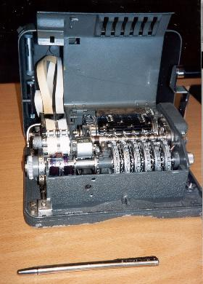
Hagelin Rotor Machine
Notes:
This photo of an Allied Hagelin machine was taken by Lawrie Brown at Eurocrypt'93 in Norway. Note pen for scale, and the rotating cipher wheels near the front.

Slide 39
Steganography
an alternative to encryption
hides existence of message
  using only a subset of letters/words in a longer message marked in some way
  using invisible ink
  hiding in LSB in graphic image or sound file
has drawbacks
  high overhead to hide relatively few info bits
Notes:
Steganography is an alternative to encryption which hides the very existence of a message by some means. There are a large range of techniques for doing this.
Steganography has a number of drawbacks when compared to encryption. It requires a lot of overhead to hide a relatively few bits of information.
Also, once the system is discovered, it becomes virtually worthless, although a message can be first encrypted and then hidden using steganography.

Slide 40
Modern Block Ciphers
now look at modern block ciphers
one of the most widely used types of cryptographic algorithms
provide secrecy /authentication services
focus on DES (Data Encryption Standard)
to illustrate block cipher design principles
Notes:
Modern block ciphers are widely used to provide encryption of quantities of information, and/or a cryptographic checksum to ensure the contents have not been altered. We continue to use block ciphers because they are comparatively fast, and because we know a fair amount about how to design them. Will use the widely known DES algorithm to illustrate some key block cipher design principles.

Slide 41
Block vs Stream Ciphers
block ciphers process messages in blocks, each of which is then en/decrypted
like a substitution on very big characters
  64-bits or more
stream ciphers process messages a bit or byte at a time when en/decrypting
many current ciphers are block ciphers
broader range of applications
Notes:
Block ciphers work a on block / word at a time, which is some number of bits. All of these bits have to be available before the block can be processed. Stream ciphers work on a bit or byte of the message at a time, hence process it as a “stream”. Block ciphers are currently better analysed, and seem to have a broader range of applications, hence focus on them.

Slide 42
Confusion and Diffusion
cipher needs to completely obscure statistical properties of original message
a one-time pad does this
more practically Shannon suggested combining S & P elements to obtain:
diffusion – dissipates statistical structure of plaintext over bulk of ciphertext
confusion – makes relationship between ciphertext and key as complex as possible
Notes:
The terms diffusion and confusion were introduced by Claude Shannon to capture the two basic building blocks for any cryptographic system. Every block cipher involves a transformation of a block of plaintext into a block of ciphertext, where the transformation depends on the key. The mechanism of diffusion seeks to make the statistical relationship between the plaintext and ciphertext as complex as possible in order to thwart attempts to deduce the key. Confusion seeks to make the relationship between the statistics of the ciphertext and the value of the encryption key as complex as possible, again to thwart attempts to discover the key.
So successful are diffusion and confusion in capturing the essence of the desired attributes of a block cipher that they have become the cornerstone of modern block cipher design.

Slide 43
Feistel Cipher Structure
Horst Feistel devised the feistel cipher
  based on concept of invertible product cipher
partitions input block into two halves
  process through multiple rounds which
  perform a substitution on left data half
  based on round function of right half & subkey
  then have permutation swapping halves
implements Shannon’s S-P net concept
Notes:
Horst Feistel, working at IBM Thomas J Watson Research Labs devised a suitable invertible cipher structure in early 70's.
One of Feistel's main contributions was the invention of a suitable structure which adapted Shannon's S-P network in an easily inverted structure. It partitions input block into two halves which are processed through multiple rounds which perform a substitution on left data half, based on round function of right half & subkey, and then have permutation swapping halves. Essentially the same h/w or s/w is used for both encryption and decryption, with just a slight change in how the keys are used. One layer of S-boxes and the following P-box are used to form the round function.

Slide 44
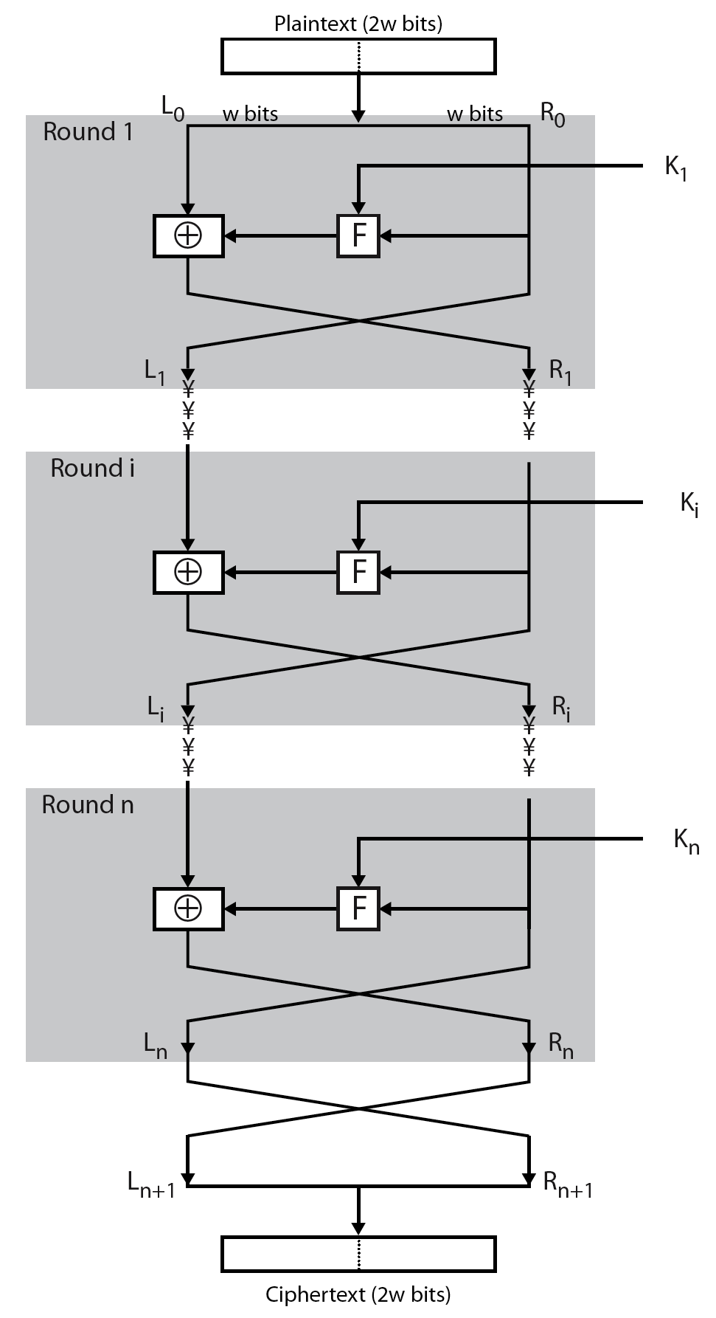
Feistel Cipher Structure
Notes:
Stallings Figure 3.2 illustrates the classical feistel cipher structure, with data split in 2 halves, processed through a number of rounds which perform a substitution on left half using output of round function on right half & key, and a permutation which swaps halves, as listed previously.

Slide 45
Feistel Cipher Design Elements
block size
key size
number of rounds
subkey generation algorithm
round function
fast software en/decryption
ease of analysis
Notes:
The exact realization of a Feistel network depends on the choice of the following parameters and design features:
block size - increasing size improves security, but slows cipher
key size - increasing size improves security, makes exhaustive key searching harder, but may slow cipher
number of rounds - increasing number improves security, but slows cipher
subkey generation algorithm - greater complexity can make analysis harder, but slows cipher
round function - greater complexity can make analysis harder, but slows cipher
fast software en/decryption - more recent concern for practical use
ease of analysis - for easier validation & testing of strength

Slide 46
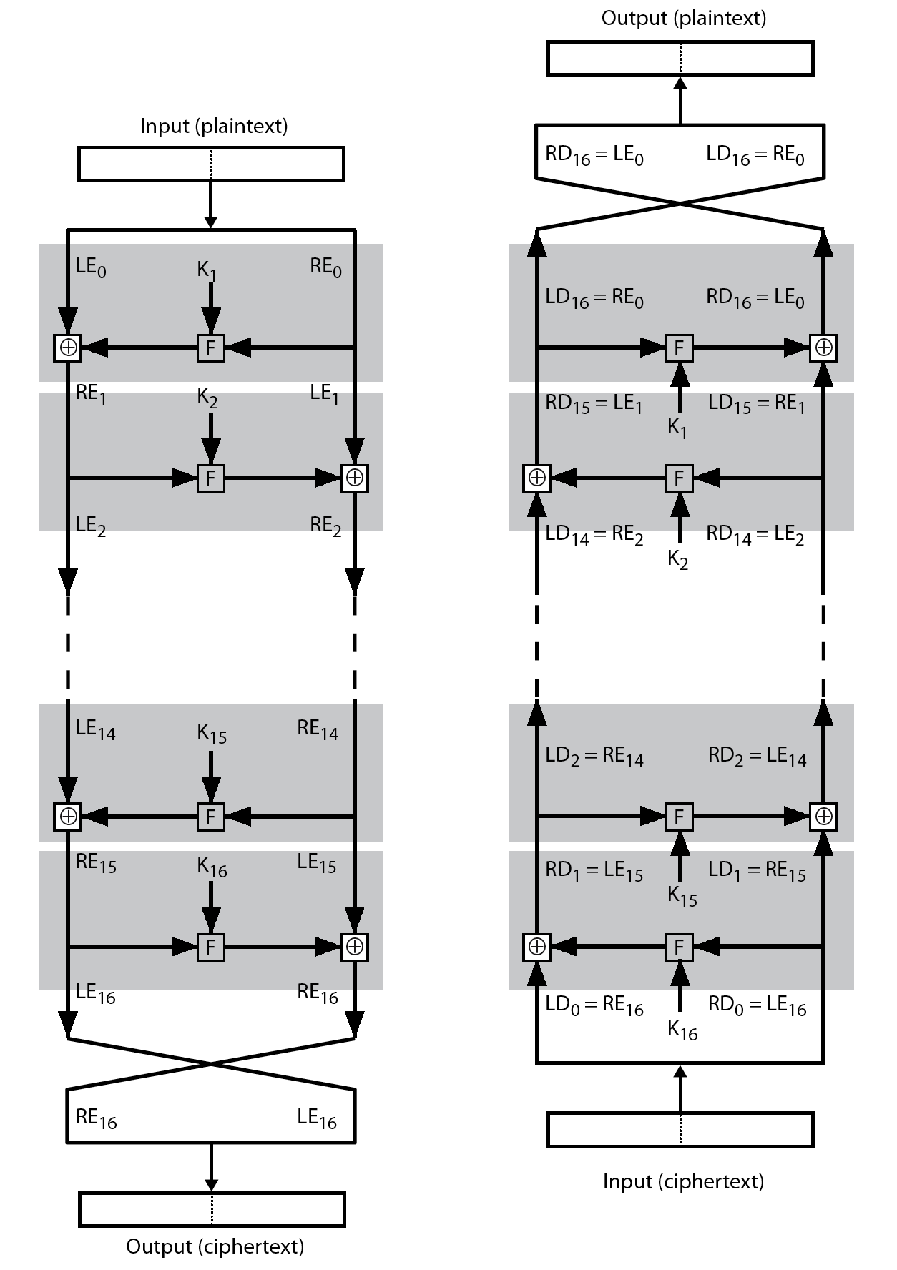
Feistel Cipher Decryption
Notes:
The process of decryption with a Feistel cipher, as shown in Stallings Figure 3.3, is essentially the same as the encryption process. The rule is as follows: Use the ciphertext as input to the algorithm, but use the subkeys Ki in reverse order. That is, use Kn in the first round, Kn–1 in the second round, and so on until K1 is used in the last round. This is a nice feature because it means we need not implement two different algorithms, one for encryption and one for decryption.

Slide 47
DES History
IBM developed Lucifer cipher
  by team led by Feistel in late 60’s
  used 64-bit data blocks with 128-bit key
then redeveloped as a commercial cipher with input from NSA and others
in 1973 NBS issued request for proposals for a national cipher standard
IBM submitted their revised Lucifer which was eventually accepted as the DES
Notes:
In the late 1960s, IBM set up a research project in computer cryptography led by Horst Feistel. The project concluded in 1971 with the development of the LUCIFER algorithm. LUCIFER is a Feistel block cipher that operates on blocks of 64 bits, using a key size of 128 bits.
Because of the promising results produced by the LUCIFER project, IBM embarked on an effort, headed by Walter Tuchman and Carl Meyer, to develop a marketable commercial encryption product that ideally could be implemented on a single chip. It involved not only IBM researchers but also outside consultants and technical advice from NSA. The outcome of this effort was a refined version of LUCIFER that was more resistant to cryptanalysis but that had a reduced key size of 56 bits, to fit on a single chip.
In 1973, the National Bureau of Standards (NBS) issued a request for proposals for a national cipher standard. IBM submitted the modified LUCIFER. It was by far the best algorithm proposed and was adopted in 1977 as the Data Encryption Standard.

Slide 48
DES Design Controversy
although DES standard is public
was considerable controversy over design
  in choice of 56-bit key (vs Lucifer 128-bit)
  and because design criteria were classified
subsequent events and public analysis show in fact design was appropriate
use of DES has flourished
  especially in financial applications
  still standardised for legacy application use
Notes:
Before its adoption as a standard, the proposed DES was subjected to intense & continuing criticism over the size of its key & the classified design criteria.
Recent analysis has shown despite this controversy, that DES is well designed. DES is theoretically broken using Differential or Linear Cryptanalysis but in practise is unlikely to be a problem yet. Also rapid advances in computing speed though have rendered the 56 bit key susceptible to exhaustive key search, as predicted by Diffie & Hellman.
DES has flourished and is widely used, especially in financial applications. It is still standardized for legacy systems, with either AES or triple DES for new applications.

Slide 49
Avalanche Effect
key desirable property of encryption alg
where a change of one input or key bit results in changing approx half output bits
making attempts to “home-in” by guessing keys impossible
DES exhibits strong avalanche
Notes:
A desirable property of any encryption algorithm is that a small change in either the plaintext or the key should produce a significant change in the ciphertext. In particular, a change in one bit of the plaintext or one bit of the key should produce a change in many bits of the ciphertext. If the change were small, this might provide a way to reduce the size of the plaintext or key space to be searched. DES exhibits a strong avalanche effect, as may be seen in Stallings Table 3.5.

Slide 50
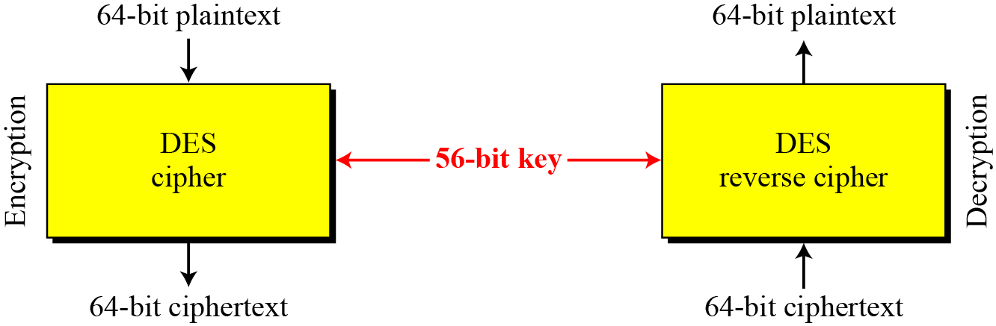
DES is a block cipher, as shown in Figure
Encryption and decryption with DES

Slide 51
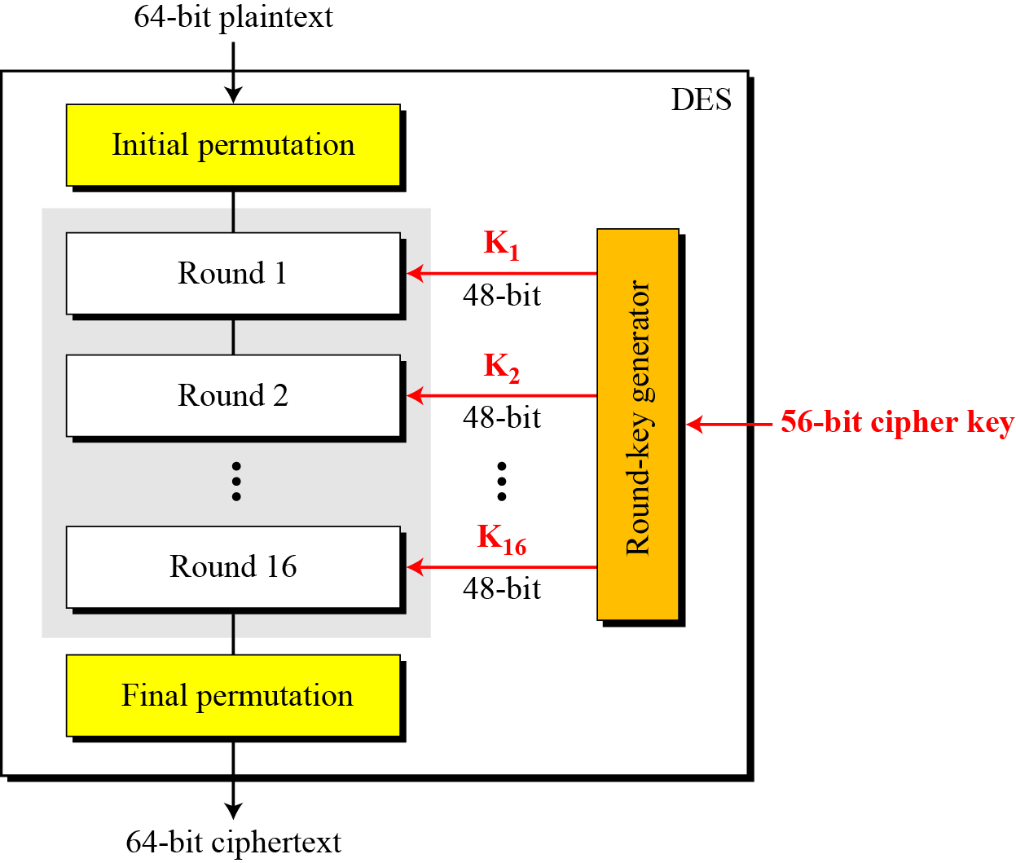
General structure of DES

Slide 52
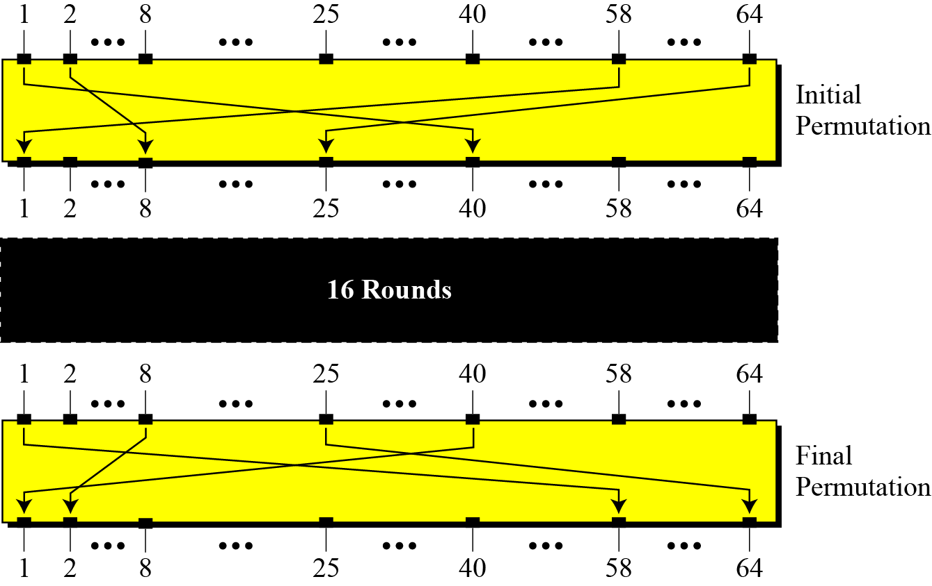
Initial and final permutation steps in DES

Slide 53
Initial and final permutation tables

Slide 54
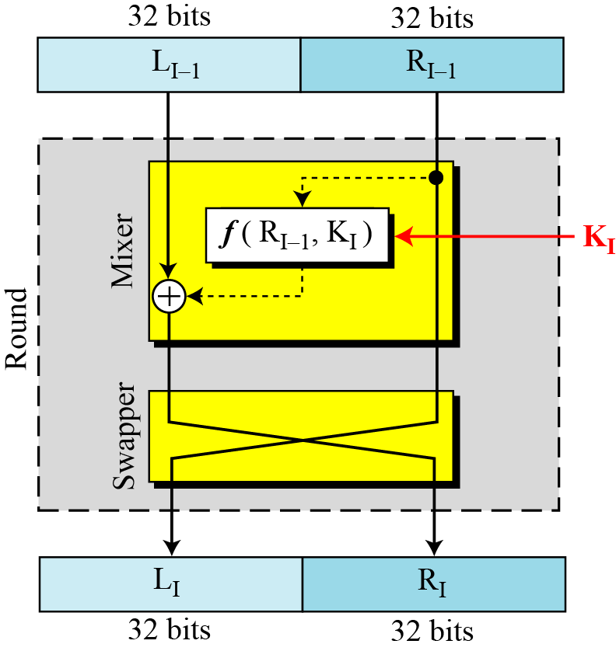
DES uses 16 rounds. Each round of DES is a Feistel cipher.
A round in DES
(encryption site)

Slide 55
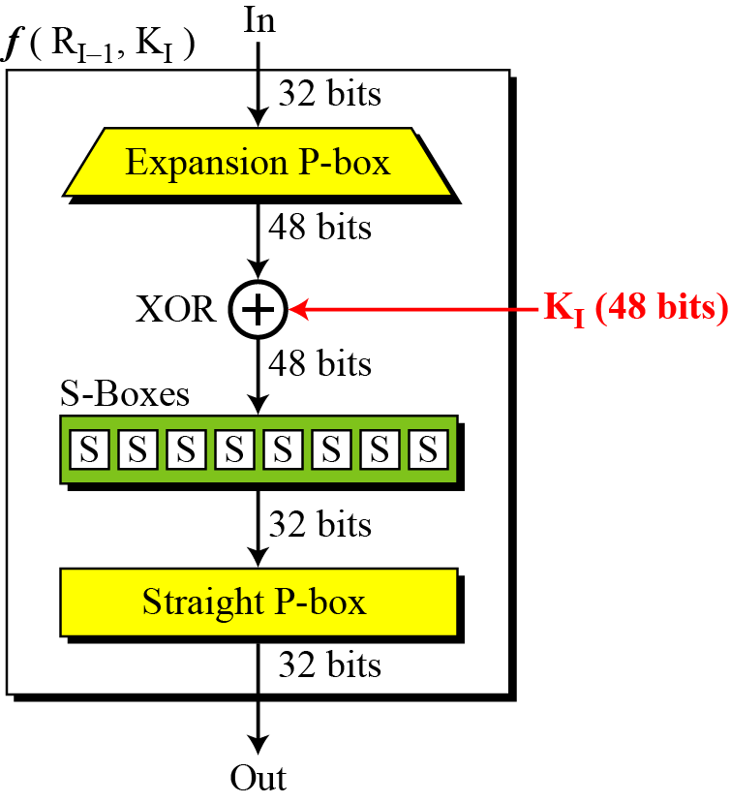
The heart of DES is the DES function. The DES function applies a 48-bit key to the rightmost 32 bits to produce a 32-bit output.
Figure 6.5
DES function

Slide 56
Although the relationship between the input and output can be defined mathematically
Table 6.6 Expansion P-box table

Slide 57
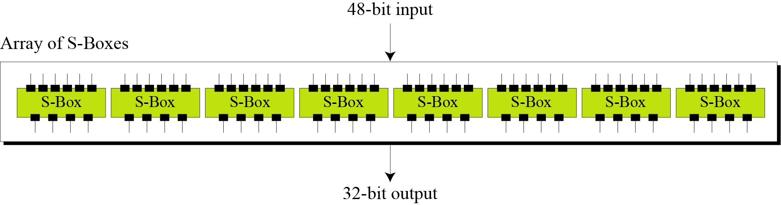
S-Boxes
The S-boxes do the real mixing (confusion). DES uses 8 S-boxes, each with a 6-bit input and a 4-bit output. See Figure

Slide 58
Table shows the permutation for S-box 1. For the rest of the boxes see the textbook.
S-box 1

Slide 59
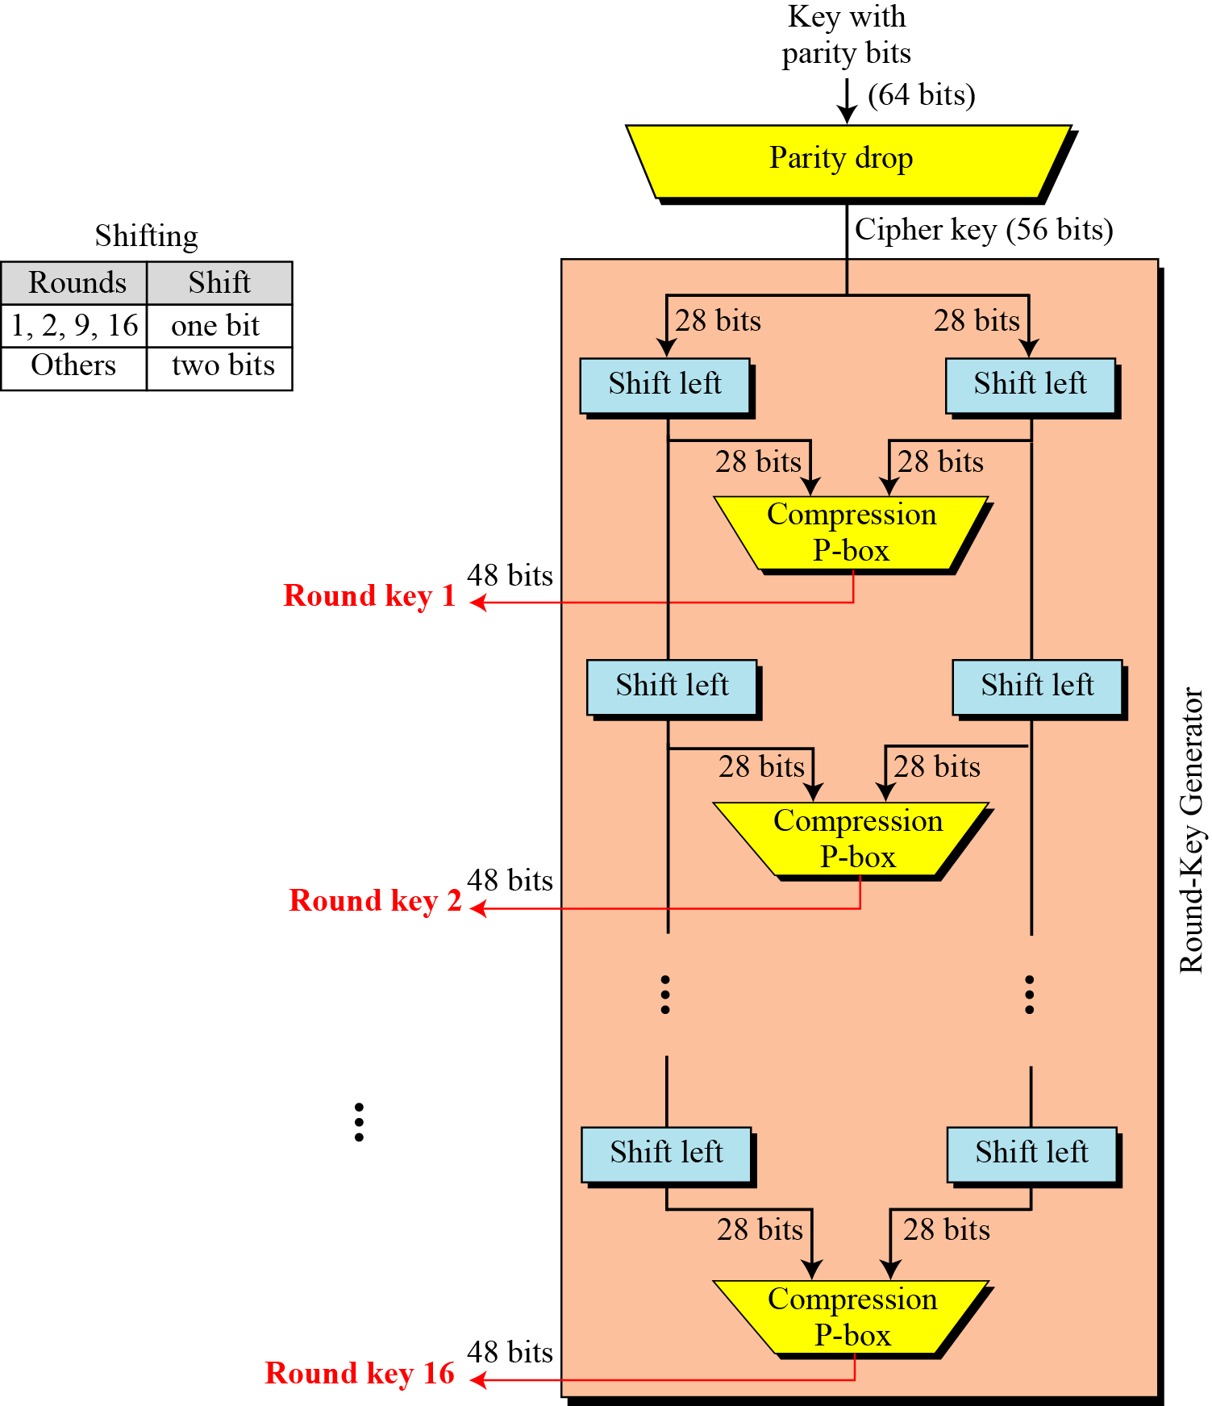
Key generation

Slide 60
Parity-bit drop table
Number of bits shifts

Slide 61
Key-compression table

Slide 62
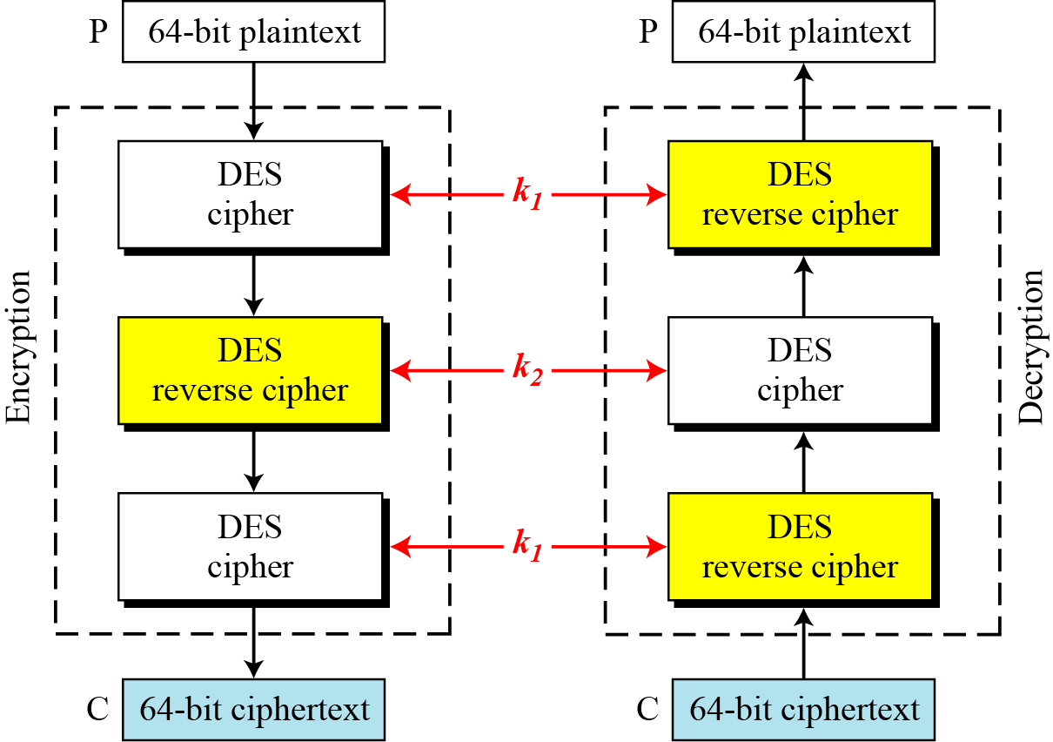
Triple DES with two keys

Slide 63
Triple DES with Three Keys
The possibility of known-plaintext attacks on triple DES with two keys has enticed some applications to use triple DES with three keys. Triple DES with three keys is used by many applications such as PGP (See Chapter 16).

Slide 64
UNIT 2

Slide 65
Prime Numbers
prime numbers only have divisors of 1 and self
  they cannot be written as a product of other numbers
  note: 1 is prime, but is generally not of interest
eg. 2,3,5,7 are prime, 4,6,8,9,10 are not
prime numbers are central to number theory

Slide 66
Prime Factorisation
to factor a number n is to write it as a product of other numbers: n=a × b × c
note that factoring a number is relatively hard compared to multiplying the factors together to generate the number
the prime factorisation of a number n is when its written as a product of primes
  eg. 91=7×13 ; 3600=2⁴×3²×5²
Notes:
The idea of "factoring" a number is important - finding numbers which divide into it. Taking this as far as can go, by factorising all the factors, we can eventually write the number as a product of (powers of) primes - its prime factorisation.

Slide 67
Relatively Prime Numbers & GCD
two numbers a, b are relatively prime if have no common divisors apart from 1
  eg. 8 & 15 are relatively prime since factors of 8 are 1,2,4,8 and of 15 are 1,3,5,15 and 1 is the only common factor
conversely can determine the greatest common divisor by comparing their prime factorizations and using least powers
  eg. 300=2¹×3¹×5² 18=2¹×3² hence GCD(18,300)=2¹×3¹×5⁰=6

Slide 68
Fermat's Theorem
a^{p-1} mod p = 1
  where p is prime and gcd(a,p)=1
also known as Fermat’s Little Theorem
useful in public key and primality testing

Slide 69
Euler Totient Function ø(n)
when doing arithmetic modulo n
complete set of residues is: 0..n-1
reduced set of residues is those numbers (residues) which are relatively prime to n
  eg for n=10,
  complete set of residues is {0,1,2,3,4,5,6,7,8,9}
  reduced set of residues is {1,3,7,9}
number of elements in reduced set of residues is called the Euler Totient Function ø(n)

Slide 70
Euler Totient Function ø(n)
to compute ø(n) need to count number of elements to be excluded
in general need prime factorization, but
  for p (p prime) ø(p) = p-1
  for p.q (p,q prime) ø(p.q) = (p-1)(q-1)
eg.
  ø(37) = 36
  ø(21) = (3–1)×(7–1) = 2×6 = 12

Slide 71
Euler's Theorem
a generalisation of Fermat's Theorem
a^{ø(n)}mod N = 1
  where gcd(a,N)=1
eg.
  a=3;n=10; ø(10)=4;
  hence 3⁴ = 81 = 1 mod 10
  a=2;n=11; ø(11)=10;
  hence 2¹⁰ = 1024 = 1 mod 11

Slide 72
Primality Testing
often need to find large prime numbers
traditionally sieve using trial division
  ie. divide by all numbers (primes) in turn less than the square root of the number
  only works for small numbers
alternatively can use statistical primality tests based on properties of primes
  for which all primes numbers satisfy property
  but some composite numbers, called pseudo-primes, also satisfy the property

Slide 73
Miller Rabin Algorithm
a test based on Fermat’s Theorem
algorithm is:
  TEST (n) is:
  1. Find integers k, q, k > 0, q odd, so that (n–1)=2^{k}q
  2. Select a random integer a, 1<a<n–1
  3. if a^{q} mod n = 1 then return (“maybe prime");
  4. for j = 0 to k – 1 do
  5. if (a^{2jq} mod n = n-1)
  then return(" maybe prime ")
  6. return ("composite")

Slide 74
Chinese Remainder Theorem
used to speed up modulo computations
working modulo a product of numbers
  eg. mod M = m₁m₂..m_{k}
Chinese Remainder theorem lets us work in each moduli m_{i} separately
since computational cost is proportional to size, this is faster than working in the full modulus M
Notes:
The CRT is so called because it is believed to have been discovered by the Chinese
mathematician Sun-Tse in around 100 AD.
It is very useful in speeding up some operations in the RSA public-key scheme.

Slide 75

Chinese Remainder Theorem
can implement CRT in several ways
to compute (A mod M) can firstly compute all (a_{i} mod m_{i}) separately and then combine results to get answer using:
Notes:
See worked examples in text.

Slide 76
Public-Key Cryptography
public-key/two-key/asymmetric cryptography involves the use of two keys:
  a public-key, which may be known by anybody, and can be used to encrypt messages, and verify signatures
  a related private-key, known only to the recipient, used to decrypt messages, and sign (create) signatures
infeasible to determine private key from public
is asymmetric because
  those who encrypt messages or verify signatures cannot decrypt messages or create signatures
Notes:
76
Asymmetric algorithms rely on one key for encryption and a different but related key for decryption. These algorithms have the following important characteristic:
• It is computationally infeasible to determine the decryption key given only knowledge of the cryptographic algorithm and the encryption key.
In addition, some algorithms, such as RSA, also exhibit the following characteristic:
• Either of the two related keys can be used for encryption, with the other used for decryption.
Anyone knowing the public key can encrypt messages or verify signatures, but cannot decrypt messages or create signatures, thanks to some clever use of number theory.

Slide 77
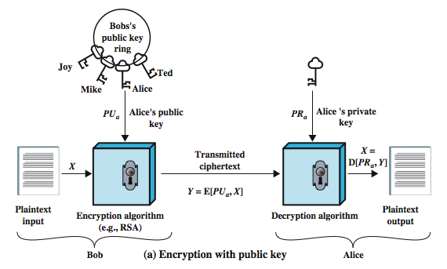
Public-Key Cryptography
Notes:
77
Stallings Figure 9.1a “Public-Key Cryptography”, shows that a public-key encryption scheme has six ingredients:
• Plaintext: the readable message /data fed into the algorithm as input.
• Encryption algorithm: performs various transformations on the plaintext.
• Public and private keys: a pair of keys selected so that if one is used for encryption, the other is used for decryption. The exact transformations performed by the algorithm depend on the public or private key that is provided as input.
• Ciphertext: the scrambled message produced as output. It depends on the plaintext and the key. For a given message, two different keys will produce two different ciphertexts.
• Decryption algorithm: accepts the ciphertext and matching key and produces the original plaintext.
Consider the following analogy using padlocked boxes: traditional schemes involve the sender putting a message in a box and locking it, sending that to the receiver, and somehow securely also sending them the key to unlock the box. The radical advance in public key schemes was to turn this around, the receiver sends an unlocked box (their public key) to the sender, who puts the message in the box and locks it (easy - and having locked it cannot get at the message), and sends the locked box to the receiver who can unlock it (also easy), having the (private) key. An attacker would have to pick the lock on the box (hard).

Slide 78
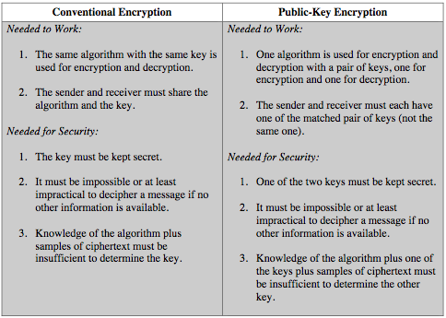
Symmetric vs Public-Key
Notes:
78
Stallings Table 9.2 summarizes some of the important aspects of symmetric and public-key encryption. To discriminate between the two, we refer to the key used in symmetric encryption as a secret key. The two keys used for asymmetric encryption are referred to as the public key and the private key. Invariably, the private key is kept secret, but it is referred to as a private key rather than a secret key to avoid confusion with symmetric encryption.

Slide 79
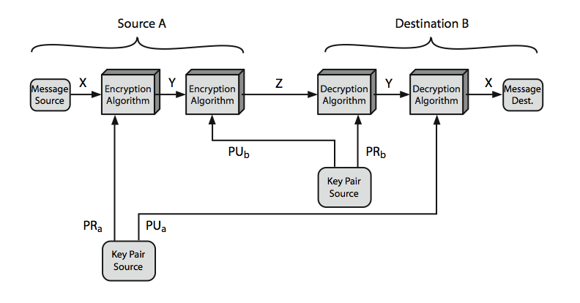
Public-Key Cryptosystems
Notes:
79
Stallings Figure 9.4 “Public-Key Cryptosystems: Secrecy and Authentication” illustrates the essential elements of a public-key encryption scheme.
Note that public-key schemes can be used for either secrecy or authentication, or both (as shown here). There is some source A that produces a message in plaintext X The M elements of X are letters in some finite alphabet. The message is intended for destination B. B generates a related pair of keys: a public key, PUb, and a private key, PRb. PRb is known only to B, whereas PUb is publicly available and therefore accessible by A. With the message X and the encryption key PUb as input, A forms the ciphertext Y = E(PUb, X) The intended receiver, in possession of the matching private key, is able to invert the transformation: X = D(PRb, Y) An adversary, observing Y and having access to PUb, but not having access to PRb or X, must attempt to recover X and/or PRb. This provides confidentiality. Can also use a public-key encryption to provide authentication: Y = E(PRa, X); X = D(PUa, Y) To provide both the authentication function and confidentiality have a double use of the public-key scheme (as shown here): Z = E(PUb, E(PRa, X)) X = D(PUa, D(PRb, Z)) In this case, separate key pairs are used for each of these purposes. The receiver owns and creates secrecy keys, sender owns and creates authentication keys.
In practice typically DO NOT do this, because of the computational cost of public-key schemes. Rather encrypt a session key which is then used with a block cipher to encrypt the actual message, and separately sign a hash of the message as a digital signature - this will be discussed more later.

Slide 80
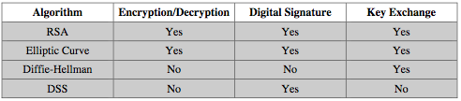
Public-Key Applications
can classify uses into 3 categories:
  encryption/decryption (provide secrecy)
  digital signatures (provide authentication)
  key exchange (of session keys)
some algorithms are suitable for all uses, others are specific to one
Notes:
80
Public-key systems are characterized by the use of a cryptographic type of algorithm with two keys. Depending on the application, the sender uses either the sender’s private key or the receiver’s public key, or both, to perform some type of cryptographic function. In broad terms, we can classify the use of public-key cryptosystems into the three categories:
• Encryption/decryption: The sender encrypts a message with the recipient’s public key.
• Digital signature: The sender “signs” a message with its private key, either to the whole message or to a small block of data that is a function of the message.
• Key exchange: Two sides cooperate to exchange a session key. Several different approaches are possible, involving the private key(s) of one or both parties.
Some algorithms are suitable for all three applications, whereas others can be used only for one or two of these applications. Stallings Table 9.3 (shown here) indicates the applications supported by the algorithms discussed in this book.

Slide 81
Public-Key Requirements
Public-Key algorithms rely on two keys where:
  it is computationally infeasible to find decryption key knowing only algorithm & encryption key
  it is computationally easy to en/decrypt messages when the relevant (en/decrypt) key is known
  either of the two related keys can be used for encryption, with the other used for decryption (for some algorithms)
these are formidable requirements which only a few algorithms have satisfied
Notes:
81
The cryptosystem illustrated in Figures 9.2 through 9.4 depends on a cryptographic algorithm based on two related keys. Diffie and Hellman postulated this system without demonstrating that such algorithms exist. However, they did lay out the conditions that such algorithms must fulfill:
It is computationally easy for a party B to generate a pair (public key PUb, private key PRb).
It is computationally easy for a sender A, knowing the public key and the message to be encrypted, M, to generate the corresponding ciphertext: C = E(PUb, M)
It is computationally easy for the receiver B to decrypt the resulting ciphertext using the private key to recover the original message: M = D(PRb, C) = D[PRb, E(PUb, M)
It is computationally infeasible for an adversary, knowing the public key, Pb, to determine the private key, PRb
It is computationally infeasible for an adversary, knowing the public key, Pb, and a ciphertext, C, to recover the original message, M.
(optional) The two keys can be applied in either order:
M = D[PU , E(PR, M)] = D[PR, E(PU, M)]
These are formidable requirements, as evidenced by the fact that only a few algorithms (RSA, elliptic curve cryptography, Diffie-Hellman, DSS) have received widespread acceptance in the several decades since the concept of public-key cryptography was proposed.

Slide 82
RSA
by Rivest, Shamir & Adleman of MIT in 1977
best known & widely used public-key scheme
Notes:
82
RSA is the best known, and by far the most widely used general public key encryption algorithm, and was first published by Rivest, Shamir & Adleman of MIT in 1978 [RIVE78]. The Rivest-Shamir-Adleman (RSA) scheme has since that time reigned supreme as the most widely accepted and implemented general-purpose approach to public-key encryption. It is based on exponentiation in a finite (Galois) field over integers modulo a prime, using large integers (eg. 1024 bits). Its security is due to the cost of factoring large numbers.

Slide 83
RSA En/decryption
to encrypt a message M the sender:
  obtains public key of recipient PU={e,n}
  computes: C = Me mod n, where 0≤M<n
to decrypt the ciphertext C the owner:
  uses their private key PR={d,n}
  computes: M = C^{d} mod n
note that the message M must be smaller than the modulus n (block if needed)
Notes:
83
The scheme developed by Rivest, Shamir, and Adleman makes use of an expression with exponentials. Plaintext is encrypted in blocks, with each block having a binary value less than some number n. The actual RSA encryption and decryption computations are each simply a single exponentiation mod (n). Both sender and receiver must know the value of n. The sender knows the value of e, and only the receiver knows the value of d. Thus, this is a public-key encryption algorithm with a public key of PU = {e, n} and a private key of PR = {d, n}. Note that the message must be smaller than the modulus. The “magic” is in the choice of the modulus and exponents which makes the system work.

Slide 84
RSA Key Setup
each user generates a public/private key pair by:
selecting two large primes at random: p, q
computing their system modulus n=p.q
  note ø(n)=(p-1)(q-1)
selecting at random the encryption key e
  where 1<e<ø(n), gcd(e,ø(n))=1
solve following equation to find decryption key d
  e.d=1 mod ø(n) and 0≤d≤n
publish their public encryption key: PU={e,n}
keep secret private decryption key: PR={d,n}
Notes:
84
The required moduls and exponent values are chosen during key setup. RSA key setup is done once (rarely) when a user establishes (or replaces) their public key, using the steps as shown. The exponent e is usually fairly small, just must be relatively prime to ø(n). Need to compute its inverse mod ø(n) to find d. It is critically important that the factors p & q of the modulus n are kept secret, since if they become known, the system can be broken. Note that different users will have different moduli n.

Slide 85
RSA Example - Key Setup
Select primes: p=17 & q=11
Calculate n = pq =17 x 11=187
Calculate ø(n)=(p–1)(q-1)=16x10=160
Select e: gcd(e,160)=1; choose e=7
Determine d: de=1 mod 160 and d < 160 Value is d=23 since 23x7=161= 10x160+1
Publish public key PU={7,187}
Keep secret private key PR={23,187}
Notes:
85
Stallings provides an example of RSA key generation using “trivial” sized numbers.
Selecting primes requires the use of a primality test.
Finding d as inverse of e mod ø(n) requires use of Euclid’s Inverse algorithm (see Ch4)

Slide 86
RSA Example - En/Decryption
sample RSA encryption/decryption is:
given message M = 88 (nb. 88<187)
encryption:
  C = 88⁷ mod 187 = 11
decryption:
  M = 11²³ mod 187 = 88
Notes:
86
Then show that the encryption and decryption operations are simple exponentiations mod 187.
Rather than having to laborious repeatedly multiply, can use the "square and multiply" algorithm with modulo reductions to implement all exponentiations quickly and efficiently (see next).

Slide 87
RSA Security
possible approaches to attacking RSA are:
  brute force key search - infeasible given size of numbers
  mathematical attacks - based on difficulty of computing ø(n), by factoring modulus n
  timing attacks - on running of decryption
  chosen ciphertext attacks - given properties of RSA
Notes:
87
Note some possible possible approaches to attacking the RSA algorithm, as shown.
The defense against the brute-force approach is the same for RSA as for other cryptosystems, namely, use a large key space. Thus the larger the number of bits in d, the better. However because the calculations involved both in key generation and in encryption/decryption are complex, the larger the size of the key, the slower the system will run.
Will now review the other possible types of attacks.

Slide 88
Timing Attacks
developed by Paul Kocher in mid-1990’s
exploit timing variations in operations
  eg. multiplying by small vs large number
  or IF's varying which instructions executed
infer operand size based on time taken
RSA exploits time taken in exponentiation
countermeasures
  use constant exponentiation time
  add random delays
  blind values used in calculations
Notes:
88
Have a radical new category of attacks developed by Paul Kocher in mid-1990’s, based on observing how long it takes to compute the cryptographic operations. Timing attacks are applicable not just to RSA, but to other public-key cryptography systems. This attack is alarming for two reasons: It comes from a completely unexpected direction and it is a ciphertext-only attack. A timing attack is somewhat analogous to a burglar guessing the combination of a safe by observing how long it takes for someone to turn the dial from number to number.
Although the timing attack is a serious threat, there are simple countermeasures that can be used, including using constant exponentiation time algorithms, adding random delays, or using blind values in calculations.

Slide 89
Diffie-Hellman Key Exchange
a public-key distribution scheme
  cannot be used to exchange an arbitrary message
  rather it can establish a common key
  known only to the two participants
value of key depends on the participants (and their private and public key information)
based on exponentiation in a finite (Galois) field (modulo a prime or a polynomial) - easy
security relies on the difficulty of computing discrete logarithms (similar to factoring) – hard
Notes:
89
The purpose of the algorithm is to enable two users to securely exchange a key that can then be used for subsequent encryption of messages. The algorithm itself is limited to the exchange of secret values, which depends on the value of the public/private keys of the participants. The Diffie-Hellman algorithm uses exponentiation in a finite (Galois) field (modulo a prime or a polynomial), and depends for its effectiveness on the difficulty of computing discrete logarithms.

Slide 90
Diffie-Hellman Setup
all users agree on global parameters:
  large prime integer or polynomial q
  a being a primitive root mod q
each user (eg. A) generates their key
  chooses a secret key (number): x_{A} < q
  compute their public key: y_{A} = a^{xA} mod q
each user makes public that key y_{A}
Notes:
90
In the Diffie-Hellman key exchange algorithm, there are two publicly known numbers: a prime number q and an integer a that is a primitive root of q. The prime q and primitive root a can be common to all using some instance of the D-H scheme. Note that the primitive root a is a number whose powers successively generate all the elements mod q. Users Alice and Bob choose random secrets x's, and then "protect" them using exponentiation to create their public y's. For an attacker monitoring the exchange of the y's to recover either of the x's, they'd need to solve the discrete logarithm problem, which is hard.

Slide 91
Diffie-Hellman Key Exchange
shared session key for users A & B is K_{AB}:
  K_{AB} = a^{xA.xB} mod q
  = y_{A}^{xB} mod q (which B can compute)
  = y_{B}^{xA} mod q (which A can compute)
K_{AB} is used as session key in private-key encryption scheme between Alice and Bob
if Alice and Bob subsequently communicate, they will have the same key as before, unless they choose new public-keys
attacker needs an x, must solve discrete log
Notes:
91
The actual key exchange for either party consists of raising the others "public key' to power of their private key. The resulting number (or as much of as is necessary) is used as the key for a block cipher or other private key scheme. For an attacker to obtain the same value they need at least one of the secret numbers, which means solving a discrete log, which is computationally infeasible given large enough numbers. Note that if Alice and Bob subsequently communicate, they will have the same key as before, unless they choose new public-keys.

Slide 92
Diffie-Hellman Example
users Alice & Bob who wish to swap keys:
agree on prime q=353 and a=3
select random secret keys:
  A chooses x_{A}=97, B chooses x_{B}=233
compute respective public keys:
  y_{A}=3⁹⁷ mod 353 = 40 (Alice)
  y_{B}=3²³³ mod 353 = 248 (Bob)
compute shared session key as:
  K_{AB}= y_{B}^{xA} mod 353 = 248⁹⁷ = 160 (Alice)
  K_{AB}= y_{A}^{xB} mod 353 = 40²³³ = 160 (Bob)
Notes:
92
Here is an example of Diffie-Hellman from the text using prime q=353, showing how each computes its public key, and then how after they exchange public keys, each can compute the common secret key.I n this simple example, it would be possible by brute force to determine the secret key 160. In particular, an attacker E can determine the common key by discovering a solution to the equation 3ª mod 353 = 40 or the equation 3^{b} mod 353 = 248. The brute-force approach is to calculate powers of 3 modulo 353, stopping when the result equals either 40 or 248. The desired answer is reached with the exponent value of 97, which provides 3⁹⁷ mod 353 = 40. With larger numbers, the problem becomes impractical.

Slide 93
ElGamal Cryptography
public-key cryptosystem related to D-H
uses exponentiation in a finite field
with security based difficulty of computing discrete logarithms, as in D-H
each user (eg. A) generates their key
  chooses a secret key (number): 1 < x_{A} < q-1
  compute their public key: y_{A} = a^{xA} mod q
Notes:
93
In 1984, T. Elgamal announced a public-key scheme based on discrete logarithms, closely related to the Diffie-Hellman technique [ELGA84, ELGA85]. The ElGamal cryptosystem is used in some form in a number of standards including the digital signature standard (DSS) and the S/MIME email standard. As with Diffie-Hellman, the global elements of ElGamal are a prime number q and a, which is a primitive root of q. User A generates a private/public key pair as shown. The security of ElGamal is based on the difficulty of computing discrete logarithms, to recover either x given y, or k given K (next slide).

Slide 94
ElGamal Message Exchange
Bob encrypts a message to send to A computing
  represent message M in range 0 <= M <= q-1
    longer messages must be sent as blocks
  chose random integer k with 1 <= k <= q-1
  compute one-time key K = y_{A}^{k} mod q
  encrypt M as a pair of integers (C₁,C₂) where
    C₁ = a^{k} mod q ; C₂ = KM mod q
A then recovers message by
  recovering key K as K = C₁^{xA} mod q
  computing M as M = C₂ K⁻¹ mod q
a unique k must be used each time
  otherwise result is insecure
Notes:
94
Any user B that has access to A's public key can encrypt a message as shown. These steps correspond to Figure 9.1a in that Alice generates a public/private key pair; Bob encrypts using Alice's public key; and Alice decrypts using her private key. See text for details of why these steps result in M being recovered. Note that K functions as a one-time key, used to encrypt and decrypt the message. If a message must be broken up into blocks and sent as a sequence of encrypted blocks, a unique value of k should be used for each block. If k is used for more than one block, knowledge of one block m of the message enables the user to compute other blocks as shown in the text.
The basic idea with El Gamal encryption is to choose a random key, protect it, then use it to scramble the message by multiplying the message with it. Two bits of info have to be sent: the first to recover this temporary key, the second the actual scrambled message. See that El Gamal encryption involves 1 modulo exponentiation and a multiplication (vs 1 exponentiation for RSA).

Slide 95
ElGamal Example
use field GF(19) q=19 and a=10
Alice computes her key:
  A chooses x_{A}=5 & computes y_{A}=10⁵ mod 19 = 3
Bob send message m=17 as (11,5) by
  chosing random k=6
  computing K = y_{A}^{k} mod q = 3⁶ mod 19 = 7
  computing C₁ = a^{k} mod q = 10⁶ mod 19 = 11;
  C₂ = KM mod q = 7.17 mod 19 = 5
Alice recovers original message by computing:
  recover K = C₁^{xA} mod q = 11⁵ mod 19 = 7
  compute inverse K⁻¹ = 7⁻¹ = 11
  recover M = C₂ K⁻¹ mod q = 5.11 mod 19 = 17
Notes:
95
Here is an example of ElGamal from the text using the prime field GF(19); that is, q = 19. It has primitive roots {2, 3, 10, 13, 14, 15}, as shown in Table 8.3. We choose a = 10. Alice generates a key pair as shown. Suppose Bob wants to send the message with the value M = 17. Then he computes the ciphertext pair (11, 5) and sends this to Alice. Alice recovers the message by first recovering K, then computing its inverse (using the Extended Euclids Algorithm – see Ch 4), and finally recovering M.

Slide 96
Elliptic Curve Cryptography
majority of public-key crypto (RSA, D-H) use either integer or polynomial arithmetic with very large numbers/polynomials
imposes a significant load in storing and processing keys and messages
an alternative is to use elliptic curves
offers same security with smaller bit sizes
newer, but not as well analysed
Notes:
96
A major issue with the use of Public-Key Cryptography, is the size of numbers used, and hence keys being stored. Recently, an alternate approach has emerged, elliptic curve cryptography (ECC), which performs the computations using elliptic curve arithmetic instead of integer or polynomial arithmetic. Already, ECC is showing up in standardization efforts, including the IEEE P1363 Standard for Public-Key Cryptography. The principal attraction of ECC, compared to RSA, is that it appears to offer equal security for a far smaller key size, thereby reducing processing overhead. Although the theory of ECC has been around for some time, it is only recently that products have begun to appear and that there has been sustained cryptanalytic interest in probing for weaknesses. Accordingly, the confidence level in ECC is not yet as high as that in RSA.

Slide 97
Real Elliptic Curves
an elliptic curve is defined by an equation in two variables x & y, with coefficients
consider a cubic elliptic curve of form
  y² = x³ + ax + b
  where x,y,a,b are all real numbers
  also define zero point O
consider set of points E(a,b) that satisfy
have addition operation for elliptic curve
  geometrically sum of P+Q is reflection of the intersection R
Notes:
97
An elliptic curve is defined by an equation in two variables, with coefficients. For cryptography, the variables and coefficients are restricted to elements in a finite field, which results in the definition of a finite abelian group (see Ch 4 for details of an abelian group). Before looking at this, we first look at elliptic curves in which the variables and coefficients are real numbers. This case is perhaps easier to visualize. Elliptic curves are not ellipses. They are so named because they are described by cubic equations, similar to those used for calculating the circumference of an ellipse. For our purpose, we can consider cubic equations for elliptic curves of the form shown here. Also included in the definition of an elliptic curve is a single element denoted O and called the point at infinity or the zero point. Now, consider the set of points E(a, b) consisting of all of the points (x, y) that satisfy this equation together with the element O. Using a different value of the pair (a, b) results in a different set E(a, b). See text for detailed rules of addition and relation to zero point O. Can derive an algebraic interpretation of addition, based on computing gradient of tangent and then solving for intersection with curve. There is also an algebraic description of additions over elliptic curves, see text.

Slide 98
UNIT 3

Slide 99
Message Authentication
message authentication is concerned with:
  protecting the integrity of a message
  validating identity of originator
  non-repudiation of origin (dispute resolution)
will consider the security requirements
then three alternative functions used:
  message encryption
  message authentication code (MAC)
  hash function
Notes:
Up till now, have been concerned with protecting message content (ie secrecy) by encrypting the message. Will now consider how to protect message integrity (ie protection from modification), as well as confirming the identity of the sender. Generically this is the problem of message authentication, and in eCommerce applications is arguably more important than secrecy.

Slide 100
Security Requirements
disclosure
traffic analysis
masquerade
content modification
sequence modification
timing modification
source repudiation
destination repudiation
Notes:
The first two requirements belong in the realm of message confidentiality, and are handled using the encryption techniques already discussed.
The remaining requirements belong in the realm of message authentication. At its core this addresses the issue of ensuring that a message comes from the alleged source and has not been altered. It may also address sequencing and timeliness. The use of a digital signature can also address issues of repudiation.

Slide 101
Message Encryption
message encryption by itself also provides a measure of authentication
if symmetric encryption is used then:
  receiver know sender must have created it
  since only sender and receiver now key used
  know content cannot of been altered
  if message has suitable structure, redundancy or a checksum to detect any changes

Slide 102
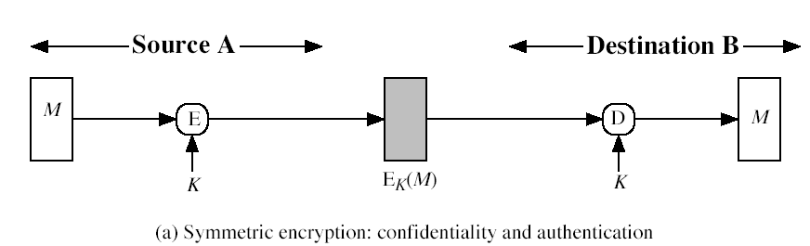
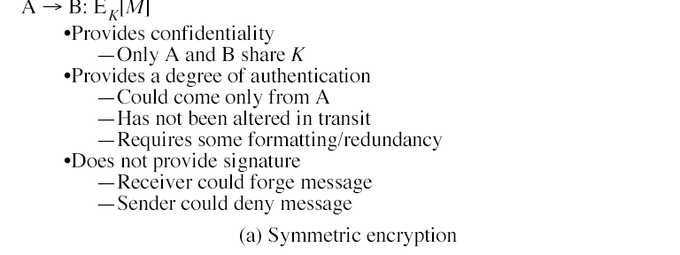

Slide 103
Digital Signatures
have looked at message authentication
  but does not address issues of lack of trust
digital signatures provide the ability to:
  verify author, date & time of signature
  authenticate message contents
  be verified by third parties to resolve disputes
hence include authentication function with additional capabilities

Slide 104
Digital Signature Properties
must depend on the message signed
must use information unique to sender
  to prevent both forgery and denial
must be relatively easy to produce
must be relatively easy to recognize & verify
be computationally infeasible to forge
  with new message for existing digital signature
  with fraudulent digital signature for given message
be practical save digital signature in storage

Slide 105
Message Authentication Code (MAC)
generated by an algorithm that creates a small fixed-sized block
  depending on both message and some key
  like encryption though need not be reversible
appended to message as a signature
receiver performs same computation on message and checks it matches the MAC
provides assurance that message is unaltered and comes from sender

Slide 106
Message Authentication Codes
as shown the MAC provides confidentiality
can also use encryption for secrecy
  generally use separate keys for each
  can compute MAC either before or after encryption
  is generally regarded as better done before
why use a MAC?
  sometimes only authentication is needed
  sometimes need authentication to persist longer than the encryption (eg. archival use)
note that a MAC is not a digital signature

Slide 107
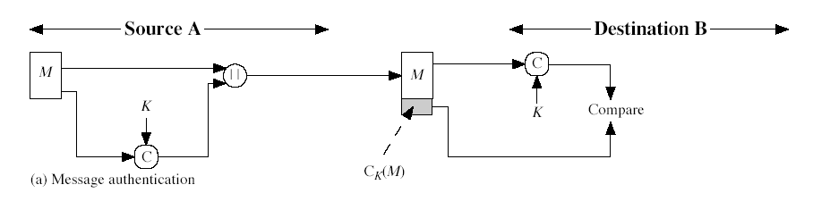
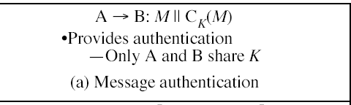

Slide 108
MAC Properties
a MAC is a cryptographic checksum
  MAC = C_{K}(M)
  condenses a variable-length message M
  using a secret key K
  to a fixed-sized authenticator
is a many-to-one function
  potentially many messages have same MAC
  but finding these needs to be very difficult

Slide 109
Hash Functions
condenses arbitrary message to fixed size
usually assume that the hash function is public and not keyed
  cf. MAC which is keyed
hash used to detect changes to message
can use in various ways with message
most often to create a digital signature

Slide 110
Hash Function Properties
a Hash Function produces a fingerprint of some file/message/data
  h = H(M)
  condenses a variable-length message M
  to a fixed-sized fingerprint
assumed to be public

Slide 111
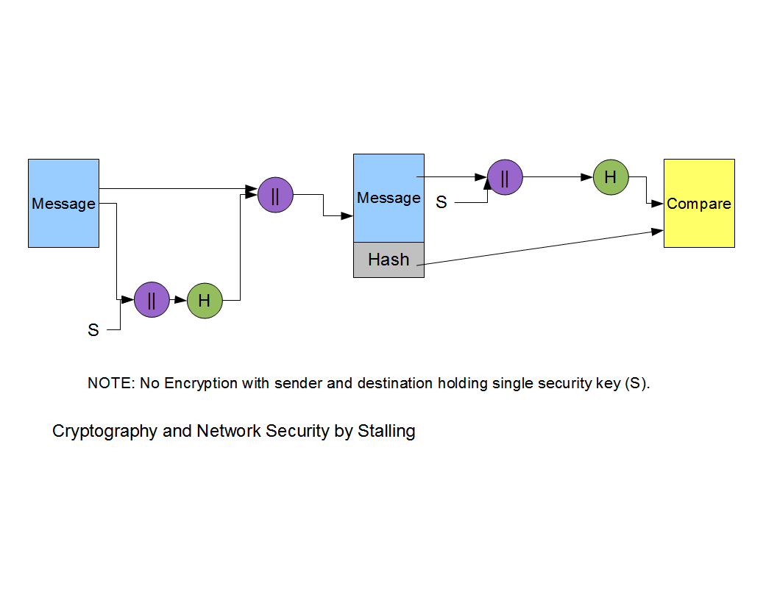
Basic Hash Function Diagram

Slide 112
Requirements for Hash Functions
can be applied to any sized message M
produces fixed-length output h
is easy to compute h=H(M) for any message M
given h is infeasible to find x s.t. H(x)=h
  one-way property
given x is infeasible to find y s.t. H(y)=H(x)
  weak collision resistance
is infeasible to find any x,y s.t. H(y)=H(x)
  strong collision resistance
Notes:
These are the specifications for good hash functions. Essentially it must be extremely difficult to find 2 messages with the same hash, and the hash should not be related to the message in any obvious way (ie it should be a complex non-linear function of the message). There are quite a few similarities in the evolution of hash functions & block ciphers, and in the evolution of the design requirements on both.

Slide 113
Simple Hash Functions
are several proposals for simple functions
based on XOR of message blocks
not secure since can manipulate any message and either not change hash or change hash also
need a stronger cryptographic function (next chapter)

Slide 114
Secure Hash Algorithm (SHA)
SHA-0 1993
SHA-1 1995
SHA-2 2002
  SHA-224, SHA-256, SHA-384, SHA-512
SHA-1
160-bit message digest
A message composed of b bits

Slide 115
SHA-1 (160 bit message)
Algorithm Framework
Step 1: Append Padding Bits….
Message is “padded” with a 1 and as many 0’s as necessary to bring the message length to 64 bits fewer than an even multiple of 512.
Step 2: Append Length....
64 bits are appended to the end of the padded message. These bits hold the binary format of 64 bits indicating the length of the original message.
http://www.herongyang.com
f

Slide 116
SHA-1 Framework Continued
Step 3: Prepare Processing Functions….
SHA1 requires 80 processing functions defined as:
f(t;B,C,D) = (B AND C) OR ((NOT B) AND D) ( 0 <= t <= 19)
f(t;B,C,D) = B XOR C XOR D (20 <= t <= 39)
f(t;B,C,D) = (B AND C) OR (B AND D) OR (C AND D) (40 <= t <=59)
f(t;B,C,D) = B XOR C XOR D (60 <= t <= 79)
Step 4: Prepare Processing Constants....
SHA1 requires 80 processing constant words defined as:
K(t) = 0x5A827999 ( 0 <= t <= 19)
K(t) = 0x6ED9EBA1 (20 <= t <= 39)
K(t) = 0x8F1BBCDC (40 <= t <= 59)
K(t) = 0xCA62C1D6 (60 <= t <= 79)
http://www.herongyang.com

Slide 117
SHA-1 Framework Continued
Step 5: Initialize Buffers….
SHA1 requires 160 bits or 5 buffers of words (32 bits):
H0 = 0x67452301
H1 = 0xEFCDAB89
H2 = 0x98BADCFE
H3 = 0x10325476
H4 = 0xC3D2E1F0
http://www.herongyang.com

Slide 118
SHA-1 Framework Final Step
Step 6: Processing Message in 512-bit blocks (L blocks in total message)….
This is the main task of SHA1 algorithm which loops through the padded and appended message in 512-bit blocks.
Input and predefined functions:
M[1, 2, ..., L]: Blocks of the padded and appended message f(0;B,C,D), f(1,B,C,D), ..., f(79,B,C,D): 80 Processing Functions K(0), K(1), ..., K(79): 80 Processing Constant Words
H0, H1, H2, H3, H4, H5: 5 Word buffers with initial values
http://www.herongyang.com

Slide 119
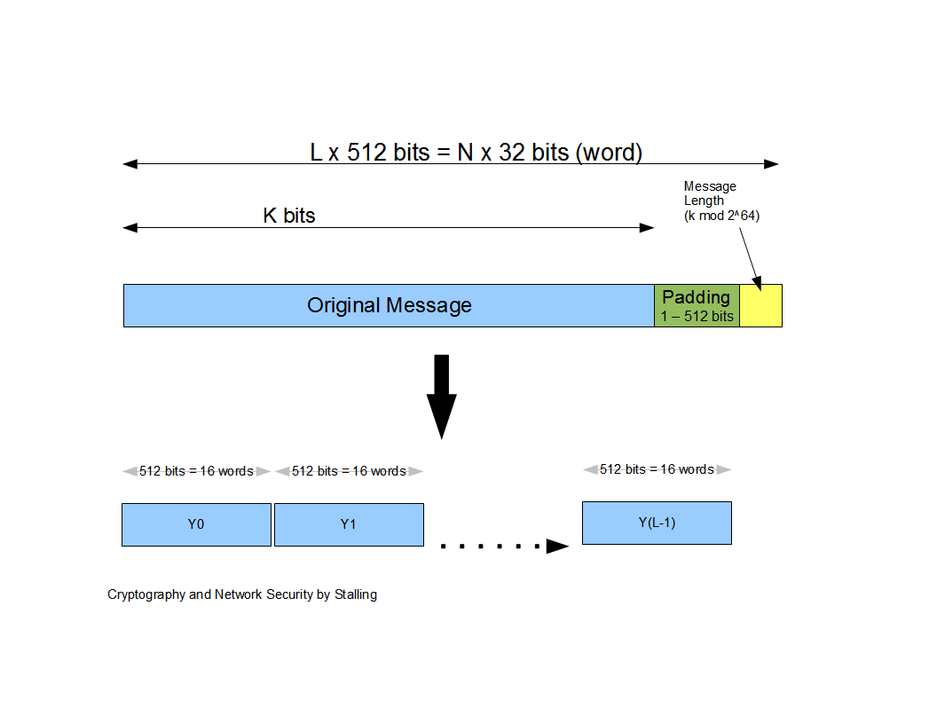
Message Diagram

Slide 120
SHA-1 Message Digest
The message digest of the string:
“This is a test for theory of computation”
4480afca4407400b035d9debeb88bfc402db514f

Slide 121
SHA
 | Output size (bits) | Internal state size (bits) | Block size (bits) | Max message size (bits) | Word size (bits) | Rounds | Operations | Collisions found
SHA-0 | 160 | 160 | 512 | 2⁶⁴ − 1 | 32 | 80 | +, and, or, xor, rot | Yes
SHA-1 | 160 | 160 | 512 | 2⁶⁴ − 1 | 32 | 80 | +, and, or, xor, rot | None (2⁵² attack)
SHA-2 | 256/224 | 256 | 512 | 2⁶⁴ − 1 | 32 | 64 | +, and, or, xor, shr, rot | None
 | 512/384 | 512 | 1024 | 2¹²⁸ − 1 | 64 | 80 | +, and, or, xor, shr, rot | None

Slide 122
Digital Signatures
have looked at message authentication
  but does not address issues of lack of trust
digital signatures provide the ability to:
  verify author, date & time of signature
  authenticate message contents
  be verified by third parties to resolve disputes
hence include authentication function with additional capabilities
Notes:
The most important development from the work on public-key cryptography is the digital signature. Message authentication protects two parties who exchange messages from any third party. However, it does not protect the two parties against each other either fraudulently creating, or denying creation, of a message. A digital signature is analogous to the handwritten signature, and provides a set of security capabilities that would be difficult to implement in any other way. It must have the following properties:
• It must verify the author and the date and time of the signature
• It must to authenticate the contents at the time of the signature
• It must be verifiable by third parties, to resolve disputes
Thus, the digital signature function includes the authentication function.

Slide 123
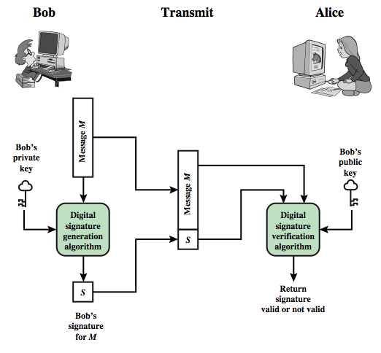
Digital Signature Model
Notes:
Stallings Figure 13.1 is a generic model of the process of making and using digital signatures. Bob can sign a message using a digital signature generation algorithm. The inputs to the algorithm are the message and Bob's private key. Any other user, say Alice, can verify the signature using a verification algorithm, whose inputs are the message, the signature, and Bob's public key.

Slide 124
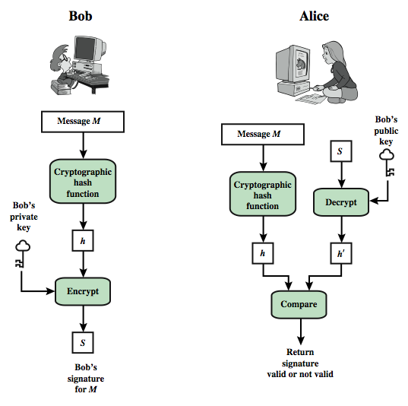
Digital Signature Model
Notes:
In simplified terms, the essence of the digital signature mechanism is shown in Stallings Figure 13.2. This repeats the logic shown in Figure 11.3. On example, using RSA, is available at this book's Web site.
We begin this chapter with an overview of digital signatures. Then, we introduce the Digital Signature Standard (DSS).

Slide 125
Digital Signature Properties
must depend on the message signed
must use information unique to sender
  to prevent both forgery and denial
must be relatively easy to produce
must be relatively easy to recognize & verify
be computationally infeasible to forge
  with new message for existing digital signature
  with fraudulent digital signature for given message
be practical save digital signature in storage
Notes:
On the basis of the properties on the previous slide, we can formulate the requirements for a digital signature as shown. A variety of approaches has been proposed for the digital signature function. These approaches fall into two categories: direct and arbitrated.

Slide 126
Direct Digital Signatures
involve only sender & receiver
assumed receiver has sender’s public-key
digital signature made by sender signing entire message or hash with private-key
can encrypt using receivers public-key
important that sign first then encrypt message & signature
security depends on sender’s private-key
Notes:
Direct Digital Signatures involve the direct application of public-key algorithms involving only the communicating parties. A digital signature may be formed by encrypting the entire message with the sender’s private key, or by encrypting a hash code of the message with the sender’s private key. Confidentiality can be provided by further encrypting the entire message plus signature using either public or private key schemes. It is important to perform the signature function first and then an outer confidentiality function, since in case of dispute, some third party must view the message and its signature. But these approaches are dependent on the security of the sender’s private-key. Will have problems if it is lost/stolen and signatures forged. Need time-stamps and timely key revocation.

Slide 127
Arbitrated Digital Signatures
involves use of arbiter A
  validates any signed message
  then dated and sent to recipient
requires suitable level of trust in arbiter
can be implemented with either private or public-key algorithms
arbiter may or may not see message
Notes:
The problems associated with direct digital signatures can be addressed by using an arbiter, in a variety of possible arrangements, as shown in Stallings Table 13.1.
The arbiter plays a sensitive and crucial role in this sort of scheme, and all parties must have a great deal of trust that the arbitration mechanism is working properly.
These schemes can be implemented with either private or public-key algorithms, and the arbiter may or may not see the actual message contents.

Slide 128
Digital Signature Requirements
must depend on the message signed
must use information unique to sender
  to prevent both forgery and denial
must be relatively easy to produce
must be relatively easy to recognize & verify
be computationally infeasible to forge
  with new message for existing digital signature
  with fraudulent digital signature for given message
be practical save digital signature in storage
Notes:
On the basis of the properties on the previous slide, we can formulate the requirements for a digital signature as shown. A variety of approaches has been proposed for the digital signature function. A secure hash function, embedded in a scheme such as that shown in Stallings Figure 13.2, provides a basis for satisfying these requirements. However care must be taken in the design of the details of the scheme. These approaches fall into two categories: direct and arbitrated.

Slide 129
Digital Signature Algorithm (DSA)
creates a 320 bit signature
with 512-1024 bit security
smaller and faster than RSA
a digital signature scheme only
security depends on difficulty of computing discrete logarithms
variant of ElGamal & Schnorr schemes
Notes:
The DSA is based on the difficulty of computing discrete logarithms (see Chapter 8) and is based on schemes originally presented by ElGamal [ELGA85] and Schnorr [SCHN91]. The DSA signature scheme has advantages, being both smaller (320 vs 1024bit) and faster (much of the computation is done modulo a 160 bit number), over RSA. Unlike RSA, it cannot be used for encryption or key exchange. Nevertheless, it is a public-key technique

Slide 130
DSA Key Generation
have shared global public key values (p,q,g):
  choose 160-bit prime number q
  choose a large prime p with 2^{L-1} < p < 2^{L}
    where L= 512 to 1024 bits and is a multiple of 64
    such that q is a 160 bit prime divisor of (p-1)
  choose g = h^{(p-1)/q}
    where 1<h<p-1 and h^{(p-1)/q} mod p > 1
users choose private & compute public key:
  choose random private key: x<q
  compute public key: y = g^{x} mod p
Notes:
DSA typically uses a common set of global parameters (p,q,g) for a community of clients, as shown. A 160-bit prime number q is chosen. Next, a prime number p is selected with a length between 512 and 1024 bits such that q divides (p – 1). Finally, g is chosen to be of the form h^{(p–1)/q} mod p where h is an integer between 1 and (p – 1) with the restriction that g must be greater than 1. Thus, the global public key components of DSA have the same for as in the Schnorr signature scheme.
Then each DSA uses chooses a random private key x, and computes their public key as shown. The calculation of the public key y given x is relatively straightforward. However, given the public key y, it is computationally infeasible to determine x, which is the discrete logarithm of y to base g, mod p.

Slide 131
DSA Signature Creation
to sign a message M the sender:
  generates a random signature key k, k<q
  nb. k must be random, be destroyed after use, and never be reused
then computes signature pair:
  r = (g^{k} mod p)mod q
  s = [k⁻¹(H(M)+ xr)] mod q
sends signature (r,s) with message M
Notes:
To create a signature, a user calculates two quantities, r and s, that are functions of the public key components (p,q,g), the user’s private key (x), the hash code of the message H(M), and an additional integer k that should be generated randomly or pseudo-randomly and be unique for each signing. This is similar to ElGamal signatures, with the use of a per message temporary signature key k, but doing calculations first mod p, then mod q to reduce the size of the result. The signature (r,s) is then sent with the message to the recipient. Note that computing r only involves calculation mod p and does not depend on message, hence can be done in advance. Similarly with randomly choosing k’s and computing their inverses.

Slide 132
DSA Signature Verification
having received M & signature (r,s)
to verify a signature, recipient computes:
  w = s⁻¹ mod q
  u1= [H(M)w ]mod q
  u2= (rw)mod q
  v = [(g^{u1} y^{u2})mod p ]mod q
if v=r then signature is verified
see Appendix A for details of proof why
Notes:
At the receiving end, verification is performed using the formulas shown. The receiver generates a quantity v that is a function of the public key components, the sender’s public key, and the hash of the incoming message. If this quantity matches the r component of the signature, then the signature is validated. Note that the difficulty of computing discrete logs is why it is infeasible for an opponent to recover k from r, or x from s. Note also that nearly all the calculations are mod q, and hence are much faster save for the last step.
The structure of this function is such that the receiver can recover r using the incoming message and signature, the public key of the user, and the global public key. It is certainly not obvious that such a scheme would work. A proof is provided in Stallings appendix K.

Slide 133
Digital Signature Standard (DSS)
US Govt approved signature scheme FIPS 186
uses the SHA hash algorithm
designed by NIST & NSA in early 90's
DSS is the standard, DSA is the algorithm
a variant on ElGamal and Schnorr schemes
creates a 320 bit signature, but with 512-1024 bit security
security depends on difficulty of computing discrete logarithms
Notes:
DSA is the US Govt approved signature scheme - designed to provide strong signatures without allowing easy use for encryption. The signature scheme has advantages, being both smaller (320 vs 1024bit) and faster (much of the computation is done modulo a 160 bit number) than RSA.

Slide 134
DSA Key Generation
have shared global public key values (p,q,g):
  a large prime p = 2^{L}
    where L= 512 to 1024 bits and is a multiple of 64
  choose q, a 160 bit prime factor of p-1
  choose g = h^{(p-1)/q}
    where h<p-1, h^{(p-1)/q} (mod p) > 1
users choose private & compute public key:
  choose x<q
  compute y = g^{x} (mod p)

Slide 135
DSA Signature Creation
to sign a message M the sender:
  generates a random signature key k, k<q
  nb. k must be random, be destroyed after use, and never be reused
then computes signature pair:
  r = (g^{k}(mod p))(mod q)
  s = (k⁻¹.SHA(M)+ x.r)(mod q)
sends signature (r,s) with message M
Notes:
Signature creation is similar to ElGamal with the use of a per message temporary signature key k, but doing calculations first mod p, then mod q to reduce the size of the result. Note that the use of the hash function SHA is explicit.
Note that only computing r involves calculation mod p and does not depend on message, hence can be done in advance.

Slide 136
DSA Signature Verification
having received M & signature (r,s)
to verify a signature, recipient computes:
  w = s⁻¹(mod q)
  u1= (SHA(M).w)(mod q)
  u2= (r.w)(mod q)
  v = (g^{u1}.y^{u2}(mod p)) (mod q)
if v=r then signature is verified
see book web site for details of proof why
Notes:
Verification also consists of comparing two computations. Note that the difficulty of computing discrete logs is why it is infeasible for an opponent to recover k from r.
Note that nearly all the calculations are mod q, and hence are much faster save for the last step.

Slide 137
UNIT 4

Slide 138
Authentication Applications
Developed to support application-level
authentication and digital signatures
Most widely used services:
– Kerberos
– X.509
Kerberos – a private-key authentication
service
X.509 – a public-key directory authentication service
•
•
•
•

Slide 139
Kerberos
Developed as part of Project
MIT
Symmetric encryption
– using no public keys
•
Athena at
•
•
Provides centralised private-key third-party
authentication in a distributed network
Version 4 and 5
•

Slide 140
Kerberos
Motivation
•
Provide security in a distributed
architecture consisting of dedicated user workstations (clients), and distributed or centralized servers
Require the user to prove his identity for each service invoked
Require that servers prove their identity to
clients
Secure, Reliable, Transparent, and
Scalable
•
•
•

Slide 141
Kerberos
Version
4
•
Uses DES, in a rather elaborate protocol,
to provide authentication
Uses an Authentication Server (AS)
•
–
–
–
–
Knows all user passwords, and stores in a DB
Shares a unique secret key with each server
Send an encrypted ticket granting ticket
TGT contains a lifetime and timestamp

Slide 142
Kerberos
Version
4
•
Uses a Ticket Granting Server (TGS)
–
–
Issues tickets to users authenticated by AS
Encrypted with a key only known by AS and
TGS
Returns a service granting ticket
–
•
Service granting ticket contains timestamp
and lifetime

Slide 143
Kerberos
Dialog
•
Problem: lifetime and no server
authenticate to user
Uses a session key
Message Exchanges
•
•
–
–
AS exchange to obtain ticket-granting
ticket
TGS exchange to obtain service granting
ticket
Client/Server authentication exchange to obtain service
–

Slide 144
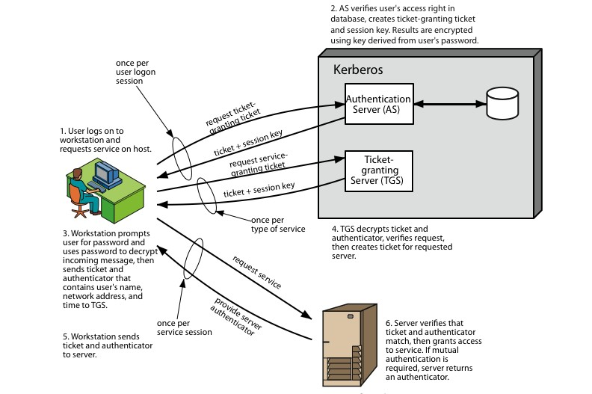
Kerberos
Overview

Slide 145
Kerberos
Realms
•
a Kerberos environment consists of:
–
–
–
a Kerberos server
a number of clients, all registered with server
application servers, sharing keys with server
•
A
Kerberos Realm
– Set of managed nodes that share the same
Kerberos database

Slide 146
Kerberos
Version
5
•
Fixes version 4 environmental
shortcomings
New elements for AS exchange:
– Realm, Options, Times, Nonce
Client/server authentication exchange
– Subkey, sequence number
•
•
•
Kerberos Ticket Flags

Slide 147
X.509
part of X.500 series
– distributed servers maintaining information database
•
user
•
defines framework for authentication services
– directory may store public-key certificates
– with public key of user signed by certification authority
also defines authentication protocols
•

Slide 148
X.509
uses public-key cryptology & digital signatures
– algorithms not standardised, but RSA
recommended
X.509 certificates are widely used
•
•
•
Public key certificate associated with each
– Generated by some trusted CA
user
•
•
Certification Authority (CA) issues certificates
The notation CA<<A>> represents a certificate for a client A signed by CA

Slide 149
X.509
Certificates
•
issued by a Certification Authority (CA), containing:
–
–
–
–
–
–
–
–
–
–
–
version 1, 2, or 3
serial number (unique within CA) identifying certificate
signature algorithm identifier
issuer X.500 name (CA)
period of validity (from - to dates)
subject X.500 name (name of owner)
subject public-key info (algorithm, parameters,
issuer unique identifier (v2+)
subject unique identifier (v2+)
extension fields (v3)
signature (of hash of all fields in certificate)
key)

Slide 150
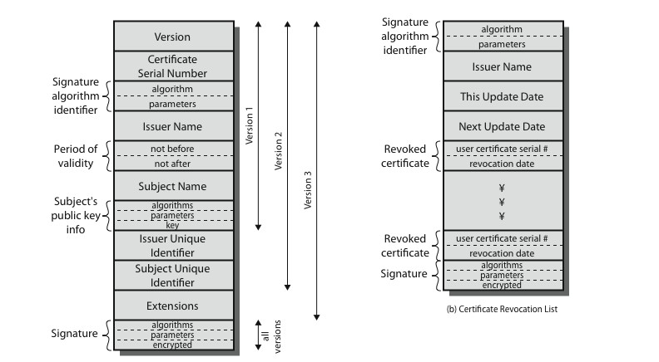
X.509
Certificates

Slide 151
Obtaining
a
User
Certificate
•
Certificate notation:
CA{…}
•
Any user with CA’s public key can verify
the user public key that was certified
•
No party other than the CA can modify
certificate without being detected
because cannot be forged, certificates
be placed in a public directory
the
•
can

Slide 152
Authentication
Procedures
•
X.509 includes three alternative
authentication procedures:
One-Way Authentication
Two-Way Authentication
Three-Way Authentication
all use public-key signatures
•
•
•
•

Slide 153
Email Security
email is one of the most widely used and
regarded network services
currently message contents are not secure
– may be inspected either in transit
– or by suitably privileged users on destination system
•
•

Slide 154
Email
Security
Enhancements
•
confidentiality
– protection from disclosure
authentication
– of sender of message
message integrity
– protection from modification
non-repudiation of origin
– protection from denial by sender
•
•
•

Slide 155
Pretty
Good
Privacy
(PGP)
•
•
•
•
•
widely used de facto secure email
developed by Phil Zimmermann selected best available crypto algs integrated into a single program
to use
available on Unix, PC, Macintosh and
Amiga systems
originally free, now have commercial versions available also
•

Slide 156
PGP Operation
– Authentication
1.
2.
sender creates a message
SHA-1 used to generate 160-bit hash code of message
hash code is encrypted with RSA using the sender's private key, and result is attached to message
receiver uses RSA or DSS with sender's public key to decrypt and recover hash code
receiver generates new hash code for message
and compares with decrypted hash code, if
match, message is accepted as authentic
3.
4.
5.

Slide 157
PGP Operation
–
Confidentiality
1.
sender generates message and random 128-bit
number to be used as session key for this message only
message is encrypted, using CAST-128 /
IDEA/3DES with session key
session key is encrypted using RSA with recipient's public key, then attached to message
receiver uses RSA with its private key to
decrypt and recover session key
session key is used to decrypt message
2.
3.
4.
5.

Slide 158
PGP Operation – Confidentiality
Authentication
uses both services on same message
&
•
–
–
–
create signature & attach to message
encrypt both message & signature
attach RSA encrypted session key

Slide 159
PGP Operation
–
Compression
•
by default PGP compresses message
after signing but before encrypting
– so can store uncompressed message &
signature for later verification
– & because compression is non deterministic
uses ZIP compression algorithm
•

Slide 160
PGP Operation – Email
Compatibility
when using PGP will have binary data
send (encrypted message etc)
•
to
•
•
however email was designed only for text
hence PGP must encode raw binary
into printable ASCII characters
uses radix-64 algorithm
– maps 3 bytes to 4 printable chars
– also appends a CRC
PGP also segments messages if too
data
•
•
big

Slide 161
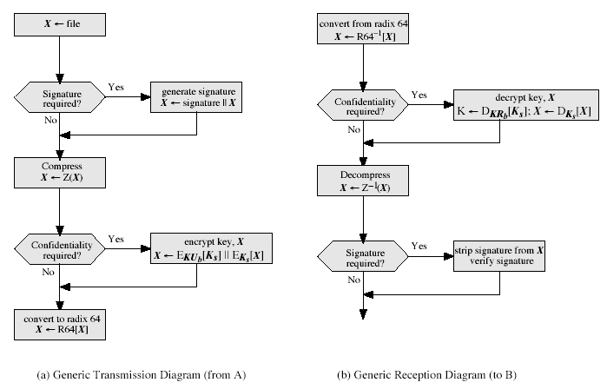
PGP Operation
–
Summary

Slide 162
S/MIME (Secure/Multipurpose
Internet Mail Extensions)
security enhancement to MIME email
•
–
–
original Internet RFC822 email was text only
MIME provided support for varying content types and multi-part messages
with encoding of binary data to textual form
S/MIME added security enhancements
–
–
•
have S/MIME support in various modern
mail agents: MS Outlook, Netscape etc

Slide 163
S/MIME
enveloped data
Functions
•
– encrypted content and associated keys
signed data
– encoded message + signed digest
clear-signed data
– cleartext message + encoded signed digest
signed & enveloped data
– nesting of signed & encrypted entities
•
•
•

Slide 164
S/MIME Cryptographic Algorithms
•
•
•
•
hash functions: SHA-1 & MD5
digital signatures: DSS & RSA
session key encryption: ElGamal
message encryption: Triple-DES,
and others
& RSA
RC2/40
•
have a procedure to decide which
algorithms to use

Slide 165
S/MIME
Certificate Processing
•
•
S/MIME uses X.509 v3 certificates
managed using a hybrid of a strict X.509
CA hierarchy & PGP’s web of trust
each client has a list of trusted CA’s certs and own public/private key pairs & certs certificates must be signed by trusted CA’s
•
•
•

Slide 166
UNIT 5

Slide 167
IP Security
general IP Security mechanisms
provides
  authentication
  confidentiality
  key management
applicable to use over LANs, across public & private WANs, & for the Internet
need identified in 1994 report
  need authentication, encryption in IPv4 & IPv6
Notes:
IP-level security encompasses three functional areas: authentication, confidentiality, and key management. The authentication mechanism assures that a received packet was transmitted by the party identified as the source in the packet header, and that the packet has not been altered in transit. The confidentiality facility enables communicating nodes to encrypt messages to prevent eavesdropping by third parties. The key management facility is concerned with the secure exchange of keys. IPSec provides the capability to secure communications across a LAN, across private and public WANs, and across the Internet.
In 1994, the Internet Architecture Board (IAB) issued a report titled "Security in the Internet Architecture" (RFC 1636). The report stated the general consensus that the Internet needs more and better security and identified key areas for security mechanisms. To provide security, the IAB included authentication and encryption as necessary security features in the next-generation IP, which has been issued as IPv6. Fortunately, these security capabilities were designed to be usable both with the current IPv4 and the future IPv6.

Slide 168
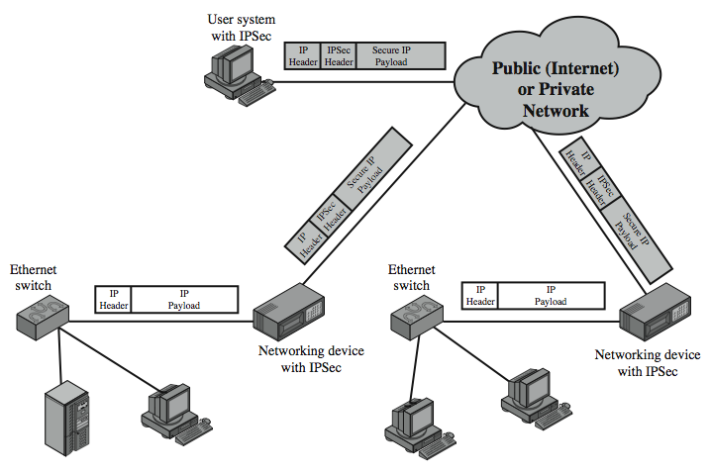
IP Security Uses
Notes:
Stallings Figure 19.1 illustrates a typical IP Security scenario. An organization maintains LANs at dispersed locations. Nonsecure IP traffic is conducted on each LAN. For traffic offsite, through some sort of private or public WAN, IPSec protocols are used. These protocols operate in networking devices, such as a router or firewall, that connect each LAN to the outside world. The IPSec networking device will typically encrypt and compress all traffic going into the WAN, and decrypt and decompress traffic coming from the WAN; these operations are transparent to workstations and servers on the LAN. Secure transmission is also possible with individual users who dial into the WAN. Such user workstations must implement the IPSec protocols to provide security.

Slide 169
Benefits of IPSec
in a firewall/router provides strong security to all traffic crossing the perimeter
in a firewall/router is resistant to bypass
is below transport layer, hence transparent to applications
can be transparent to end users
can provide security for individual users
secures routing architecture
Notes:
Some of the benefits of IPSec include:
• When implemented in a firewall or router, it provides strong security that can be applied to all traffic crossing the perimeter. Traffic within a company or workgroup does not incur the overhead of security-related processing.
• in a firewall is resistant to bypass if all traffic from the outside must use IP and the firewall is the only means of entrance from the Internet into the organization.
• is below the transport layer (TCP, UDP) and so is transparent to applications. There is no need to change software on a user or server system when IPsec is implemented in the firewall or router. Even if IPsec is implemented in end systems, upper-layer software, including applications, is not affected.
• can be transparent to end users. There is no need to train users on security mechanisms, issue keying material on a per-user basis, or revoke keying material when users leave the organization.
• can provide security for individual users if needed. This is useful for offsite workers and for setting up a secure virtual subnetwork within an organization for sensitive applications.
It also plays a vital role in the routing architecture required for internetworking.

Slide 170
IP Security Architecture
specification is quite complex, with groups:
  Architecture
    RFC4301 Security Architecture for Internet Protocol
  Authentication Header (AH)
    RFC4302 IP Authentication Header
  Encapsulating Security Payload (ESP)
    RFC4303 IP Encapsulating Security Payload (ESP)
  Internet Key Exchange (IKE)
    RFC4306 Internet Key Exchange (IKEv2) Protocol
  Cryptographic algorithms
  Other
Notes:
The IPSec specification has become quite complex. key management. The totality of the IPsec specification is scattered across dozens of RFCs and draft IETF documents, making this the most complex and difficult to grasp of all IETF specifications. The best way to keep track of and get a handle on this body of work is to consult the latest version of the IPsec document roadmap. The documents can be categorized into the following groups:
• Architecture: Covers the general concepts, security requirements, definitions, and mechanisms defining IPsec technology, see RFC 4301, Security Architecture for the Internet Protocol.
• Authentication Header (AH): AH is an extension header for message authentication, now deprecated. See RFC 4302, IP Authentication Header.
• Encapsulating Security Payload (ESP): ESP consists of an encapsulating header and trailer used to provide encryption or combined encryption/authentication. See RFC 4303, IP Encapsulating Security Payload (ESP).
• Internet Key Exchange (IKE): a collection of documents describing the key management schemes for use with IPsec. See RFC4306, Internet Key Exchange (IKEv2) Protocol, and other related RFCs.
• Cryptographic algorithms: a large set of documents that define and describe cryptographic algorithms for encryption, message authentication, pseudorandom functions (PRFs), and cryptographic key exchange.
• Other: There are a variety of other IPsec-related RFCs, including those dealing with security policy and management information base (MIB) content.

Slide 171
IPSec Services
Access control
Connectionless integrity
Data origin authentication
Rejection of replayed packets
  a form of partial sequence integrity
Confidentiality (encryption)
Limited traffic flow confidentiality
Notes:
IPSec provides security services at the IP layer by enabling a system to select required security protocols, determine the algorithm(s) to use for the service(s), and put in place any cryptographic keys required to provide the requested services. Two protocols are used to provide security: an authentication protocol designated by the header of the protocol, Authentication Header (AH); and a combined encryption/authentication protocol designated by the format of the packet for that protocol, Encapsulating Security Payload (ESP). RFC 4301 lists the security services supported as shown above.

Slide 172
Transport and Tunnel Modes
Transport Mode
  to encrypt & optionally authenticate IP data
  can do traffic analysis but is efficient
  good for ESP host to host traffic
Tunnel Mode
  encrypts entire IP packet
  add new header for next hop
  no routers on way can examine inner IP header
  good for VPNs, gateway to gateway security
Notes:
Both AH and ESP support two modes of use: transport and tunnel mode, but will focus on ESP.
Transport mode provides protection primarily for upper-layer protocols. Transport mode ESP is used to encrypt and optionally authenticate the data carried by IP. Typically, transport mode is used for end-to-end communication between two hosts (e.g., a client and a server, or two workstations). When a host runs AH or ESP over IPv4, the payload is the data that normally follow the IP header. For IPv6, the payload is the data that normally follow both the IP header and any IPv6 extensions headers that are present. Transport mode operation provides confidentiality for any application that uses it, thus avoiding the need to implement confidentiality in every individual application.
Tunnel mode ESP is used to encrypt an entire IP packet. To achieve this, after the AH or ESP fields are added to the IP packet, the entire packet plus security fields is treated as the payload of new "outer" IP packet with a new outer IP header. The entire original, or inner, packet travels through a "tunnel" from one point of an IP network to another; no routers along the way are able to examine the inner IP header. Tunnel mode is useful in a configuration that includes a firewall or other sort of security gateway that protects a trusted network from external networks. In this latter case, encryption occurs only between an external host and the security gateway or between two security gateways. With tunnel mode, a number of hosts on networks behind firewalls may engage in secure communications without implementing IPsec.

Slide 173
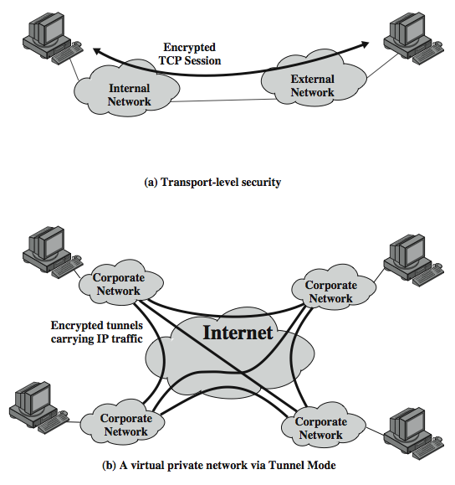
Transport and
Tunnel Modes
Notes:
Stallings Figure 19.7 shows two ways in which the IPsec ESP service can be used. In the upper part of the figure, encryption (and optionally authentication) is provided directly between two hosts. Figure 19.7b shows how tunnel mode operation can be used to set up a virtual private network. In this example, an organization has four private networks interconnected across the Internet. Hosts on the internal networks use the Internet for transport of data but do not interact with other Internet- based hosts. By terminating the tunnels at the security gateway to each internal network, the configuration allows the hosts to avoid implementing the security capability. The former technique is support by a transport mode SA, while the latter technique uses a tunnel mode SA.

Slide 174
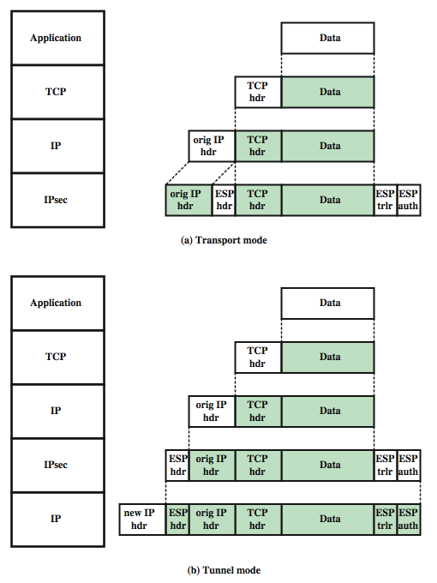
Transport and
Tunnel Mode
Protocols
Notes:
Stallings Figure 19.9 shows the protocol architecture for the two modes when ESP is used.

Slide 175
Encapsulating Security Payload (ESP)
provides message content confidentiality, data origin authentication, connectionless integrity, an anti-replay service, limited traffic flow confidentiality
services depend on options selected when establish Security Association (SA), net location
can use a variety of encryption & authentication algorithms
Notes:
ESP can be used to provide confidentiality, data origin authentication, connectionless integrity, an anti-replay service (a form of partial sequence integrity), and (limited) traffic flow confidentiality. The set of services provided depends on options selected at the time of Security Association (SA) establishment and on the location of the implementation in a network topology. ESP can work with a variety of encryption and authentication algorithms, including authenticated encryption algorithms such as GCM.

Slide 176
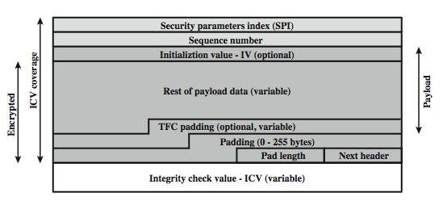
Encapsulating Security Payload
Notes:
Stallings Figure 19.5b shows the format of an ESP packet, with fields:
• Security Parameters Index (32 bits): Identifies a security association
• Sequence Number (32 bits): A monotonically increasing counter value; this provides an anti-replay function
• Payload Data (variable): This is a transport-level segment (transport mode) or IP packet (tunnel mode) that is protected by encryption
• Padding (0–255 bytes): for various reasons
• Pad Length (8 bits): the number of pad bytes immediately preceding this field
• Next Header (8 bits): identifies the type of data in the payload data field
• Integrity check value (variable): a variable-length field that contains the Integrity Check Value computed over the ESP packet
When any combined mode algorithm is employed, it is expected to return both the decrypted plaintext and a pass/fail indication for the integrity check.
Two additional fields may be present in the payload. An initialization value (IV), or nonce, is present if this is required by the encryption or authenticated encryption algorithm used for ESP. If tunnel mode is being used, then the IPsec implementation may add traffic flow confidentiality (TFC) padding after the Payload Data and before the Padding field, as explained subsequently.

Slide 177
Encryption & Authentication Algorithms & Padding
ESP can encrypt payload data, padding, pad length, and next header fields
  if needed have IV at start of payload data
ESP can have optional ICV for integrity
  is computed after encryption is performed
ESP uses padding
  to expand plaintext to required length
  to align pad length and next header fields
  to provide partial traffic flow confidentiality
Notes:
The Payload Data, Padding, Pad Length, and Next Header fields are encrypted by the ESP service. If the algorithm used to encrypt the payload requires cryptographic synchronization data, such as an initialization vector (IV), then these data may be carried explicitly at the beginning of the Payload Data field. If included, an IV is usually not encrypted, although it is often referred to as being part of the ciphertext.
The ICV field is optional. It is present only if the integrity service is selected and is provided by either a separate integrity algorithm or a combined mode algorithm that uses an ICV. The ICV is computed after the encryption is performed.
The Padding field serves several purposes: If an encryption algorithm requires the plaintext to be a multiple of some number of bytes, the Padding field is used to expand the plaintext to the required length; to assure that the Pad Length and Next Header fields are right aligned within a 32-bit word; to provide partial traffic flow confidentiality by concealing the actual length of the payload.

Slide 178
Combining Security Associations
SA’s can implement either AH or ESP
to implement both need to combine SA’s
  form a security association bundle
  may terminate at different or same endpoints
  combined by
    transport adjacency
    iterated tunneling
combining authentication & encryption
  ESP with authentication, bundled inner ESP & outer AH, bundled inner transport & outer ESP
Notes:
An individual SA can implement either the AH or ESP protocol but not both. Sometimes a particular traffic flow will call for the services provided by both AH and ESP. Further, a particular traffic flow may require IPSec services between hosts and ,for that same flow, separate services between security gateways, such as firewalls. In all of these cases, multiple SAs must be employed for the same traffic flow to achieve the desired IPSec services. The term security association bundle refers to a sequence of SAs through which traffic must be processed to provide a desired set of IPSec services. The SAs in a bundle may terminate at different endpoints or at the same endpoints.
Security associations may be combined into bundles in two ways:
• Transport adjacency: more than one security protocol on same IP packet, without invoking tunneling
• Iterated tunneling: application of multiple layers of security protocols effected through IP tunneling
Encryption and authentication can be combined in order to transmit an IP packet that has both confidentiality and authentication between hosts. We look at several approaches, including: ESP with authentication option, use two bundled transport SAs, with the inner being an ESP SA and the outer being an AH SA; use a bundle consisting of an inner AH transport SA and an outer ESP tunnel SA. See text for more details.

Slide 179
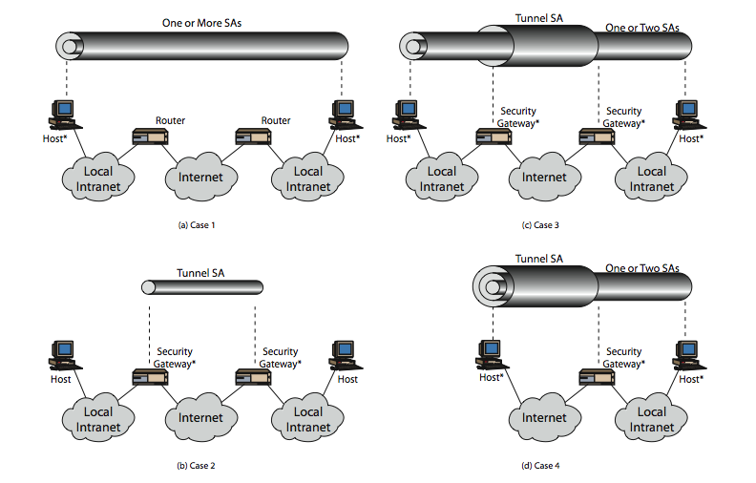
Combining Security Associations
Notes:
The IPSec Architecture document lists four examples of combinations of SAs that must be supported by compliant IPSec hosts or security gateways. These are illustrated in Stallings Figure 19.10. The lower part of each case in the figure represents the physical connectivity of the elements; the upper part represents logical connectivity via one or more nested SAs. Each SA can be either AH or ESP. For host-to-host SAs, the mode may be either transport or tunnel; otherwise it must be tunnel mode. Note the *’d devices implement IPSec. The cases are:
Case 1 security is provided between end systems that implement IPSec, who share suitable keys, using AH tunnel, ESP transport, ESP + AH transport, any of above inside AH/ESP tunnel; to support authentication, encryption, authentication before encryption, and authentication after encryption.
Case 2 security is provided only between gateways (routers, firewalls,etc.) and no hosts implement IPSec, a simple VPN using a single AH or ESP tunnel SA
Case 3 builds on Case 2 by adding end-to-end security .The same combinations discussed for cases 1 and 2 are allowed here.
Case 4 provides support for a remote host that uses the Internet to reach an organization’s firewall and then to gain access to some server or workstation behind the firewall. Only tunnel mode is required between the remote host and the firewall. As in Case 1, one or two SAs may be used between the remote host and the local host.

Slide 180
IPSec Key Management
handles key generation & distribution
typically need 2 pairs of keys
  2 per direction for AH & ESP
manual key management
  sysadmin manually configures every system
automated key management
  automated system for on demand creation of keys for SA’s in large systems
  has Oakley & ISAKMP elements
Notes:
The key management portion of IPSec involves the determination and distribution of secret keys. A typical requirement is four keys for communication between two applications: transmit and receive pairs for both AH and ESP. The IPSec Architecture document mandates support for two types of key management:
• Manual where a system administrator manually configures each system with its own keys and with the keys of other communicating
• Automated where an automated system enables the on-demand creation of keys for SAs and facilitates the use of keys in a large distributed system with an evolving configuration
The default automated key management protocol for IPSec is referred to as ISAKMP/Oakley.

Slide 181
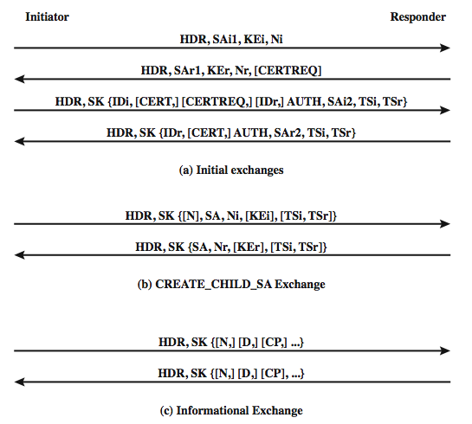
IKEV2 Exchanges
Notes:
The IKEv2 protocol involves the exchange of messages in pairs. The first two pairs of exchanges are referred to as the initial exchanges (see Stallings Figure 19.11a). In the first exchange the two peers exchange information concerning cryptographic algorithms and other security parameters they are willing to use along with nonces and Diffie-Hellman (DH) values. The result of this exchange is to set up a special SA called the IKE SA (Figure 19.2). This SA defines parameters for a secure channel between the peers over which subsequent message exchanges take place. Thus, all subsequent IKE message exchanges are protected by encryption and message authentication. In the second exchange, the two parties authenticate one another and set up a first IPsec SA to be placed in the SADB and used for protecting ordinary (i.e. non-IKE) communications between the peers. Thus four messages are needed to establish the first SA for general use. The CREATE_CHILD_SA exchange can be used to establish further SAs for protecting traffic. The informational exchange is used to exchange management information, IKEv2 error messages, and other notifications.

Slide 182
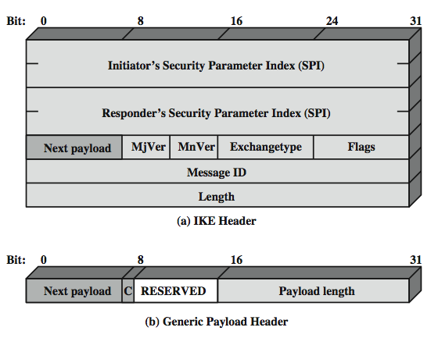
ISAKMP
Notes:
An ISAKMP message consists of an ISAKMP header followed by one or more payloads, carried in a transport protocol (UDP by default).
Stallings Figure19.12a shows the header format for an ISAKMP message, which includes the fields:
• Initiator SPI (64 bits): chosen by the initiator to identify a unique SA
• Responder Cookie (64 bits): chosen by responder to identify unique IKE SA
• Next Payload (8 bits): type of the first payload in the message.
• Major/Minor Version (4 bits): Indicates major/minor version of IKE in use
• Exchange Type (8 bits): type of exchange.
• Flags (8 bits): specific options set for this IKE exchange.
• Message ID (32 bits): control retransmission, matching of requests /responses.
• Length (32 bits): of total message (header plus all payloads) in octets.
All ISAKMP payloads begin with the same generic payload header shown in Figure 12.12b. The Next Payload field has a value of 0 if this is the last payload in the message; otherwise its value is the type of the next payload. The Payload Length field indicates the length in octets of this payload, including the generic payload header. The critical bit is zero if the sender wants the recipient to skip this payload if it does not understand the payload type code in the Next Payload field of the previous payload. It is set to one if the sender wants the recipient to reject this entire message if it does not understand the payload type.

Slide 183
IKE Payloads & Exchanges
have a number of ISAKMP payload types:
  Security Association, Key Exchange, Identification, Certificate, Certificate Request, Authentication, Nonce, Notify, Delete, Vendor ID, Traffic Selector, Encrypted, Configuration, Extensible Authentication Protocol
payload has complex hierarchical structure
may contain multiple proposals, with multiple protocols & multiple transforms
Notes:
Stallings Table19.3 summarizes the payload types defined for ISAKMP, and lists the fields, or parameters, that are part of each payload. The SA payload is used to begin the establishment of an SA. The payload has a complex, hierarchical structure. The payload may contain multiple proposals. Each proposal may contain multiple protocols. Each protocol may contain multiple transforms. And each transform may contain multiple attributes. These elements are formatted as substructures within the payload with proposal, transform and attribute. See text for more details.

Slide 184
Cryptographic Suites
variety of cryptographic algorithm types
to promote interoperability have
  RFC4308 defines VPN cryptographic suites
    VPN-A matches common corporate VPN security using 3DES & HMAC
    VPN-B has stronger security for new VPNs implementing IPsecv3 and IKEv2 using AES
  RFC4869 defines four cryptographic suites compatible with US NSA specs
    provide choices for ESP & IKE
    AES-GCM, AES-CBC, HMAC-SHA, ECP, ECDSA
Notes:
The IPsecv3 and IKEv3 protocols rely on a variety of types of cryptographic algorithms. To promote interoperability, two RFCs define recommended suites of cryptographic algorithms and parameters for various applications. RFC 4308 defines two cryptographic suites for establishing virtual private networks. Suite VPN-A matches the commonly used corporate VPN security used in older IKEv1 implementations. Suite VPN-B provides stronger security and is recommended for new VPNs that implement IPsecv3 and IKEv2. Stallings Table 19.4a lists the algorithms and parameters for the two suites. For symmetric cryptography, VPN-A relies on 3DES and HMAC, while VPN-B relies exclusively on AES.
RFC 4869 defines four optional cryptographic suites compatible with the US National Security Agency's Suite B specifications. The four suites defined in RFC 4869 provide choices for ESP and IKE. They are differentiated by the choice of cryptographic algorithm strengths and a choice of whether ESP is to provide both confidentiality and integrity or integrity only. All of the suites offer greater protection than the two VPN suites defined in RFC 4308. Stallings Table 19.4b lists the algorithms and parameters for these suites. For ESP, authenticated encryption is provided using the GCM mode with either 128-bit or 256-bit AES keys. For IKE encryption, CBC is used, as it was for the VPN suites. For ESP, if only authentication is required, then GMAC is used. For IKE, message authentication is provided using HMAC with one of the SHA-3 hash functions. As with the VPN suites, IKEv2 in these suites generates pseudorandom bits by repeated use of the MAC used for message authentication. For the Diffie-Hellman algorithm, the use of elliptic curve groups modulo a prime is specified. Finally, for authentication, elliptic curve digital signatures are listed.

Slide 186
Web Security
Web now widely used by business, government, individuals
but Internet & Web are vulnerable
have a variety of threats
  integrity
  confidentiality
  denial of service
  authentication
need added security mechanisms

Slide 187
SSL (Secure Socket Layer)
transport layer security service
originally developed by Netscape
version 3 designed with public input
subsequently became Internet standard known as TLS (Transport Layer Security)
uses TCP to provide a reliable end-to-end service
SSL has two layers of protocols
Notes:
SSL probably most widely used Web security mechanism. Its implemented at the Transport layer; cf IPSec at Network layer; or various Application layer mechanisms eg. S/MIME & SET (later).

Slide 188
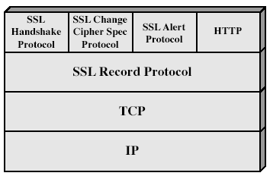
SSL Architecture
Notes:
Stallings Fig 17-2.

Slide 189
SSL Architecture
SSL session
  an association between client & server
  created by the Handshake Protocol
  define a set of cryptographic parameters
  may be shared by multiple SSL connections
SSL connection
  a transient, peer-to-peer, communications link
  associated with 1 SSL session

Slide 190
SSL Record Protocol
confidentiality
  using symmetric encryption with a shared secret key defined by Handshake Protocol
  IDEA, RC2-40, DES-40, DES, 3DES, Fortezza, RC4-40, RC4-128
  message is compressed before encryption
message integrity
  using a MAC with shared secret key
  similar to HMAC but with different padding
Notes:
SSL Record Protocol defines these two services for SSL connections.

Slide 191
SSL Change Cipher Spec Protocol
one of 3 SSL specific protocols which use the SSL Record protocol
a single message
causes pending state to become current
hence updating the cipher suite in use

Slide 192
SSL Alert Protocol
conveys SSL-related alerts to peer entity
severity
    warning or fatal
specific alert
    unexpected message, bad record mac, decompression failure, handshake failure, illegal parameter
    close notify, no certificate, bad certificate, unsupported certificate, certificate revoked, certificate expired, certificate unknown
compressed & encrypted like all SSL data

Slide 193
SSL Handshake Protocol
allows server & client to:
  authenticate each other
  to negotiate encryption & MAC algorithms
  to negotiate cryptographic keys to be used
comprises a series of messages in phases
  Establish Security Capabilities
  Server Authentication and Key Exchange
  Client Authentication and Key Exchange
  Finish

Slide 194
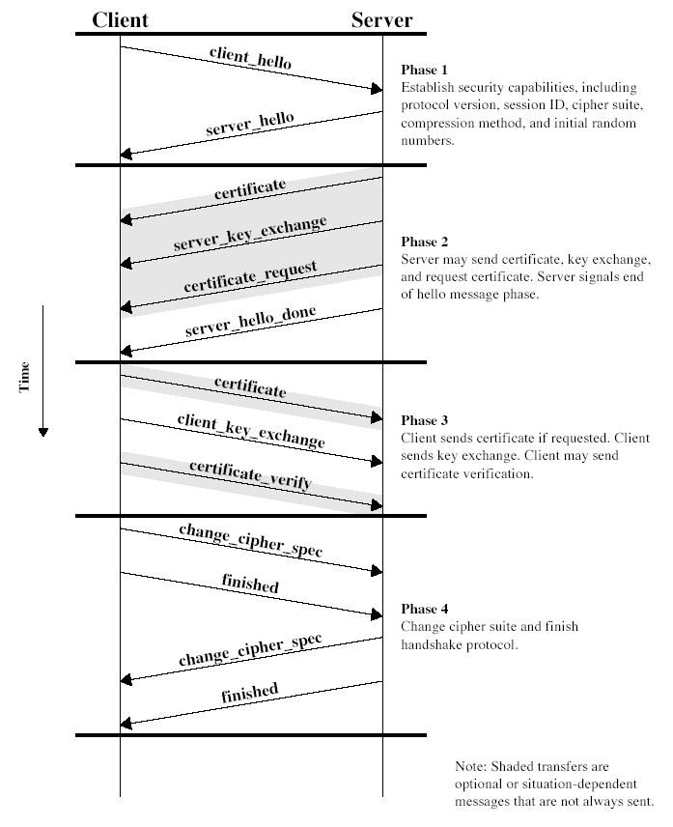
SSL Handshake Protocol
Notes:
Stallings Fig 17-6.

Slide 195
Secure Electronic Transactions (SET)
open encryption & security specification
to protect Internet credit card transactions
developed in 1996 by Mastercard, Visa etc
not a payment system
rather a set of security protocols & formats
  secure communications amongst parties
  trust from use of X.509v3 certificates
  privacy by restricted info to those who need it

Slide 196
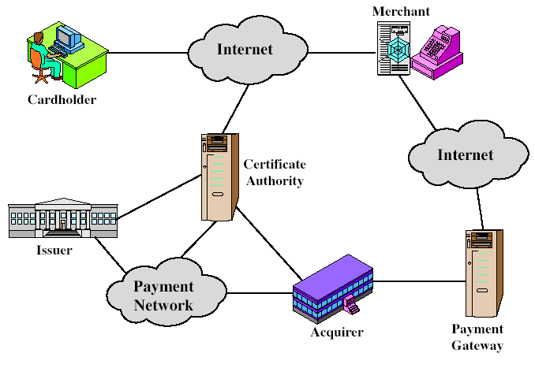
SET Components
Notes:
Stallings Fig 17-8.

Slide 197
SET Transaction
customer opens account
customer receives a certificate
merchants have their own certificates
customer places an order
merchant is verified
order and payment are sent
merchant requests payment authorization
merchant confirms order
merchant provides goods or service
merchant requests payment

Slide 198
Dual Signature
customer creates dual messages
  order information (OI) for merchant
  payment information (PI) for bank
neither party needs details of other
but must know they are linked
use a dual signature for this
  signed concatenated hashes of OI & PI

Slide 199
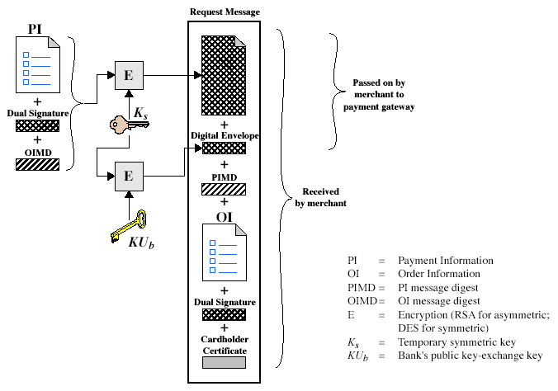
Purchase Request – Customer
Notes:
Stallings Fig 17-10.

Slide 200
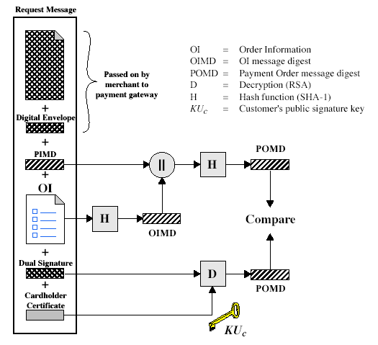
Purchase Request – Merchant
Notes:
Stallings Fig 17-11.

Slide 201
Purchase Request – Merchant
verifies cardholder certificates using CA sigs
verifies dual signature using customer's public signature key to ensure order has not been tampered with in transit & that it was signed using cardholder's private signature key
processes order and forwards the payment information to the payment gateway for authorization (described later)
sends a purchase response to cardholder

Slide 202
Payment Gateway Authorization
verifies all certificates
decrypts digital envelope of authorization block to obtain symmetric key & then decrypts authorization block
verifies merchant's signature on authorization block
decrypts digital envelope of payment block to obtain symmetric key & then decrypts payment block
verifies dual signature on payment block
verifies that transaction ID received from merchant matches that in PI received (indirectly) from customer
requests & receives an authorization from issuer
sends authorization response back to merchant

Slide 203
Payment Capture
merchant sends payment gateway a payment capture request
gateway checks request
then causes funds to be transferred to merchants account
notifies merchant using capture response

Slide 205
SYSTEM LEVEL SECURITY
Intrusion Detection
Password Management
Viruses and related threats
Virus Counter measures
Firewall design principles
Trusted Systems

Slide 206
Intruders
significant issue for networked systems is hostile or unwanted access
either via network or local
can identify classes of intruders:
  masquerader
  misfeasor
  clandestine user
varying levels of competence
Notes:
A significant security problem for networked systems is hostile, or at least unwanted, trespass being unauthorized login or use of a system, by local or remote users; or by software such as a virus, worm, or Trojan horse.
One of the two most publicized threats to security is the intruder (or hacker or cracker), which Anderson identified three classes of:
• Masquerader: An individual who is not authorized to use the computer (outsider)
• Misfeasor: A legitimate user who accesses unauthorized data, programs, or resources (insider)
• Clandestine user: An individual who seizes supervisory control of the system and uses this control to evade auditing and access controls or to suppress audit collection (either)
Intruder attacks range from the benign (simply exploring net to see what is there); to the serious (who attempt to read privileged data, perform unauthorized modifications, or disrupt system)

Slide 207
Intrusion Techniques
aim to gain access and/or increase privileges on a system
basic attack methodology
  target acquisition and information gathering
  initial access
  privilege escalation
  covering tracks
key goal often is to acquire passwords
so then exercise access rights of owner
Notes:
Knowing the standard attack methods is a key element in limiting your vulnerability. The basic aim is to gain access and/or increase privileges on some system. The basic attack methodology list is taken from McClure et al "Hacking Exposed".
A basic technique for gaining access is to acquire a user (preferably administrator) password, so the attacker can login and exercise all the access rights of the account owner.

Slide 208
Intrusion Detection
inevitably will have security failures
so need also to detect intrusions so can
  block if detected quickly
  act as deterrent
  collect info to improve security
assume intruder will behave differently to a legitimate user
  but will have imperfect distinction between
Notes:
Inevitably, the best intrusion prevention system will fail. A system’s second line of defense is intrusion detection, which aims to detect intrusions so can: block access & minimize damage if detected quickly; act as deterrent given chance of being caught; or can collect info on intruders to improve future security.
Intrusion detection is based on the assumption that the behavior of the intruder differs from that of a legitimate user in ways that can be quantified. This is imperfect at best.

Slide 209
Password Guessing
one of the most common attacks
attacker knows a login (from email/web page etc)
then attempts to guess password for it
  defaults, short passwords, common word searches
  user info (variations on names, birthday, phone, common words/interests)
  exhaustively searching all possible passwords
check by login or against stolen password file
success depends on password chosen by user
surveys show many users choose poorly
Notes:
Password guessing is a common attack. If an attacker has obtained a poorly protected password file, then can mount attack off-line, so target is unaware of its progress. Some O/S take less care than others with their password files. If have to actually attempt to login to check guesses, then system should detect an abnormal number of failed logins, and hence trigger appropriate countermeasures by admins/security. Likelihood of success depends very much on how well the passwords are chosen. Unfortunately, users often don’t choose well (see later).

Slide 210
Password Management
front-line defense against intruders
users supply both:
  login – determines privileges of that user
  password – to identify them
passwords often stored encrypted
  Unix uses multiple DES (variant with salt)
  more recent systems use crypto hash function
should protect password file on system
Notes:
The front line of defense against intruders is the password system, where a user provides a name/login identifier (ID) and a password. The password serves to authenticate the ID of the individual logging on to the system. Passwords are usually stored encrypted rather than in the clear (which would make them more vulnerable to theft). Unix systems traditionally used a multiple DES variant with salt as a one-way hash function (see text). More recent O/S’s use a cryptographic hash function (eg. MD5). The file containing these passwords hashes needs access control protections to make guessing attacks harder.

Slide 211
Managing Passwords - Education
can use policies and good user education
educate on importance of good passwords
give guidelines for good passwords
  minimum length (>6)
  require a mix of upper & lower case letters, numbers, punctuation
  not dictionary words
but likely to be ignored by many users
Notes:
Goal is to eliminate guessable passwords while allowing user to select a memorable password. Four basic techniques are in use: education, computer generation, reactive checking & proactive checking.
The user education strategy tells users the importance of using hard-to-guess passwords and provides guidelines for selecting strong passwords, but it needs their cooperation. The problem is that many users will simply ignore the guidelines.

Slide 212
Managing Passwords - Computer Generated
let computer create passwords
if random likely not memorisable, so will be written down (sticky label syndrome)
even pronounceable not remembered
have history of poor user acceptance
FIPS PUB 181 one of best generators
  has both description & sample code
  generates words from concatenating random pronounceable syllables
Notes:
Computer-generated passwords create a password for the user, but have problems. If the passwords are quite random in nature, users will not be able to remember them. Even if the password is pronounceable, the user may have difficulty remembering it and so be tempted to write it down. In general, computer-generated password schemes have a history of poor acceptance by users. FIPS PUB 181 defines one of the best-designed automated password generators. The standard includes not only a description of the approach but also a complete listing of the C source code of the algorithm, which generates words by forming a random set of pronounceable syllables and concatenating them to form a word.

Slide 213
Malicious Software

Slide 214
Viruses and Other Malicious Content
computer viruses have got a lot of publicity
one of a family of malicious software
effects usually obvious
have figured in news reports, fiction, movies (often exaggerated)
getting more attention than deserve
are a concern though

Slide 215
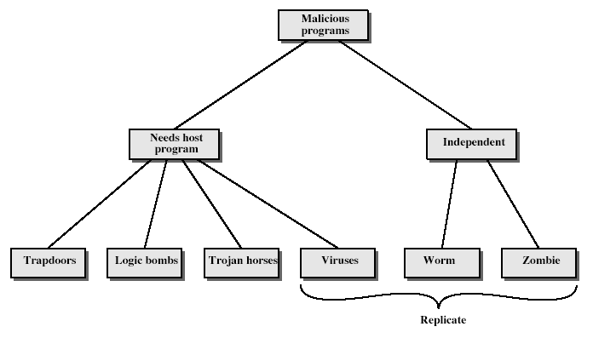
Malicious Software
Notes:
Stallings Fig 19-1.
Taxonomy can be divided into two categories: those that need a host program, and those that are independent;
can also differentiate between those software threats that do not replicate and those that do.

Slide 216
Trapdoors
secret entry point into a program
allows those who know access bypassing usual security procedures
have been commonly used by developers
a threat when left in production programs allowing exploited by attackers
very hard to block in O/S
requires good s/w development & update

Slide 217
Logic Bomb
one of oldest types of malicious software
code embedded in legitimate program
activated when specified conditions met
  eg presence/absence of some file
  particular date/time
  particular user
when triggered typically damage system
  modify/delete files/disks

Slide 218
Trojan Horse
program with hidden side-effects
which is usually superficially attractive
  eg game, s/w upgrade etc
when run performs some additional tasks
  allows attacker to indirectly gain access they do not have directly
often used to propagate a virus/worm or install a backdoor
or simply to destroy data

Slide 219
Zombie
program which secretly takes over another networked computer
then uses it to indirectly launch attacks
often used to launch distributed denial of service (DDoS) attacks
exploits known flaws in network systems

Slide 220
Viruses
a piece of self-replicating code attached to some other code
  cf biological virus
both propagates itself & carries a payload
  carries code to make copies of itself
  as well as code to perform some covert task

Slide 221
Virus Operation
virus phases:
  dormant – waiting on trigger event
  propagation – replicating to programs/disks
  triggering – by event to execute payload
  execution – of payload
details usually machine/OS specific
  exploiting features/weaknesses

Slide 222
Types of Viruses
can classify on basis of how they attack
parasitic virus
memory-resident virus
boot sector virus
stealth
polymorphic virus
macro virus

Slide 223
Macro Virus
macro code attached to some data file
interpreted by program using file
  eg Word/Excel macros
  esp. using auto command & command macros
code is now platform independent
is a major source of new viral infections
blurs distinction between data and program files making task of detection much harder
classic trade-off: "ease of use" vs "security"

Slide 224
Email Virus
spread using email with attachment containing a macro virus
  cf Melissa
triggered when user opens attachment
or worse even when mail viewed by using scripting features in mail agent
usually targeted at Microsoft Outlook mail agent & Word/Excel documents

Slide 225
Worms
replicating but not infecting program
typically spreads over a network
  cf Morris Internet Worm in 1988
  led to creation of CERTs
using users distributed privileges or by exploiting system vulnerabilities
widely used by hackers to create zombie PC's, subsequently used for further attacks, esp DoS
major issue is lack of security of permanently connected systems, esp PC's

Slide 226
Worm Operation
worm phases like those of viruses:
  dormant
  propagation
    search for other systems to infect
    establish connection to target remote system
    replicate self onto remote system
  triggering
  execution

Slide 227
Virus Countermeasures
viral attacks exploit lack of integrity control on systems
to defend need to add such controls
typically by one or more of:
  prevention - block virus infection mechanism
  detection - of viruses in infected system
  reaction - restoring system to clean state

Slide 228
Anti-Virus Software
first-generation
  scanner uses virus signature to identify virus
  or change in length of programs
second-generation
  uses heuristic rules to spot viral infection
  or uses program checksums to spot changes
third-generation
  memory-resident programs identify virus by actions
fourth-generation
  packages with a variety of antivirus techniques
  eg scanning & activity traps, access-controls

Slide 229
Advanced Anti-Virus Techniques
generic decryption
  use CPU simulator to check program signature & behavior before actually running it
digital immune system (IBM)
  general purpose emulation & virus detection
  any virus entering org is captured, analyzed, detection/shielding created for it, removed

Slide 230
Firewalls

Slide 231
Introduction
seen evolution of information systems
now everyone want to be on the Internet
and to interconnect networks
has persistent security concerns
  can’t easily secure every system in org
need "harm minimisation"
a Firewall usually part of this

Slide 232
What is a Firewall?
a choke point of control and monitoring
interconnects networks with differing trust
imposes restrictions on network services
  only authorized traffic is allowed
auditing and controlling access
  can implement alarms for abnormal behavior
is itself immune to penetration
provides perimeter defence

Slide 233
Firewall Limitations
cannot protect from attacks bypassing it
  eg sneaker net, utility modems, trusted organisations, trusted services (eg SSL/SSH)
cannot protect against internal threats
  eg disgruntled employee
cannot protect against transfer of all virus infected programs or files
  because of huge range of O/S & file types

Slide 234
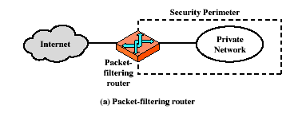
Firewalls – Packet Filters

Slide 235
Firewalls – Packet Filters
simplest of components
foundation of any firewall system
examine each IP packet (no context) and permit or deny according to rules
hence restrict access to services (ports)
possible default policies
  that not expressly permitted is prohibited
  that not expressly prohibited is permitted

Slide 236
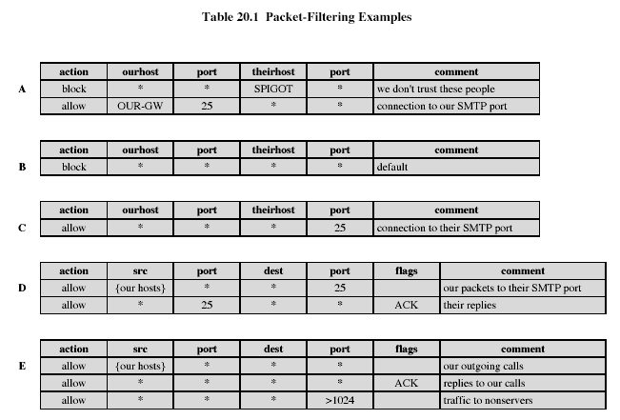
Firewalls – Packet Filters
Notes:
Stallings Table 20-1.

Slide 237
Attacks on Packet Filters
IP address spoofing
  fake source address to be trusted
  add filters on router to block
source routing attacks
  attacker sets a route other than default
  block source routed packets
tiny fragment attacks
  split header info over several tiny packets
  either discard or reassemble before check

Slide 238
Firewalls – Stateful Packet Filters
examine each IP packet in context
  keeps tracks of client-server sessions
  checks each packet validly belongs to one
better able to detect bogus packets out of context

Slide 239
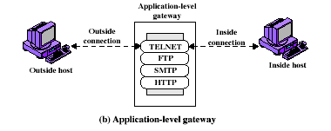
Firewalls - Application Level Gateway (or Proxy)

Slide 240
Firewalls - Application Level Gateway (or Proxy)
use an application specific gateway / proxy
has full access to protocol
  user requests service from proxy
  proxy validates request as legal
  then actions request and returns result to user
need separate proxies for each service
  some services naturally support proxying
  others are more problematic
  custom services generally not supported

Slide 241
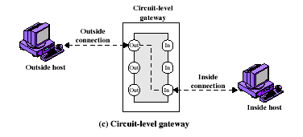
Firewalls - Circuit Level Gateway

Slide 242
Firewalls - Circuit Level Gateway
relays two TCP connections
imposes security by limiting which such connections are allowed
once created usually relays traffic without examining contents
typically used when trust internal users by allowing general outbound connections
SOCKS commonly used for this

Slide 243
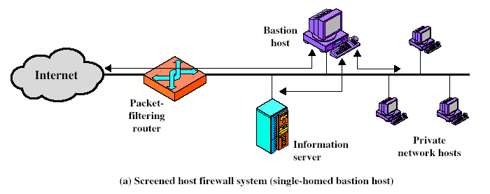
Firewall Configurations
Notes:
Stallings Fig 20-2.

Slide 244
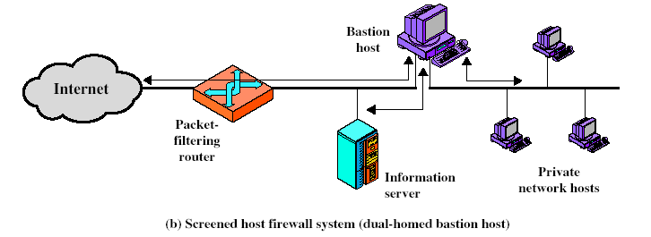
Firewall Configurations
Notes:
Stallings Fig 20-2.

Slide 245

Firewall Configurations
Notes:
Stallings Fig 20-2.

Slide 246
ACCESS CONTROL

Slide 247
Access Control
given system has identified a user
determine what resources they can access
general model is that of access matrix with
  subject - active entity (user, process)
  object - passive entity (file or resource)
  access right – way object can be accessed
can decompose by
  columns as access control lists
  rows as capability tickets

Slide 248

Access Control Matrix
Notes:
Stallings Fig 20-3.

Slide 249
TRUSTED SYSTEMS

Slide 250
Trusted Computer Systems
information security is increasingly important
have varying degrees of sensitivity of information
  cf military info classifications: confidential, secret etc
subjects (people or programs) have varying rights of access to objects (information)
want to consider ways of increasing confidence in systems to enforce these rights
known as multilevel security
  subjects have maximum & current security level
  objects have a fixed security level classification

Slide 251

Reference Monitor
Notes:
Stallings Fig 20-4.
Controlling element which enforces the security policies.

Slide 252
Evaluated Computer Systems
governments can evaluate IT systems
against a range of standards:
  TCSEC, IPSEC and now Common Criteria
define a number of “levels” of evaluation with increasingly stringent checking
have published lists of evaluated products
  though aimed at government/defense use
  can be useful in industry also

